Slide 1
Binomial probability
On the TI-84
Figuring out the X

Slide 2
What is Binomial? A Yes or No situation
Did you get the right answer? How many times?
It was either right – or not!
Did the spinner land on 5? How many times?
It was either 5 – or not!
In that bunch of birds, was that a red-tailed hawk? How many birds?
They were either red-tailed hawks, or not!
How many planes were late?
They were either late – or not!
There are two possible outcomes – but they may not have even chance of happening.
You need to be given the probability of it happening (each time), and the grand total of times that it happened (the n ).

Slide 3
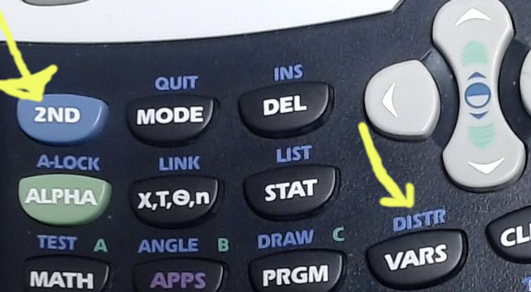
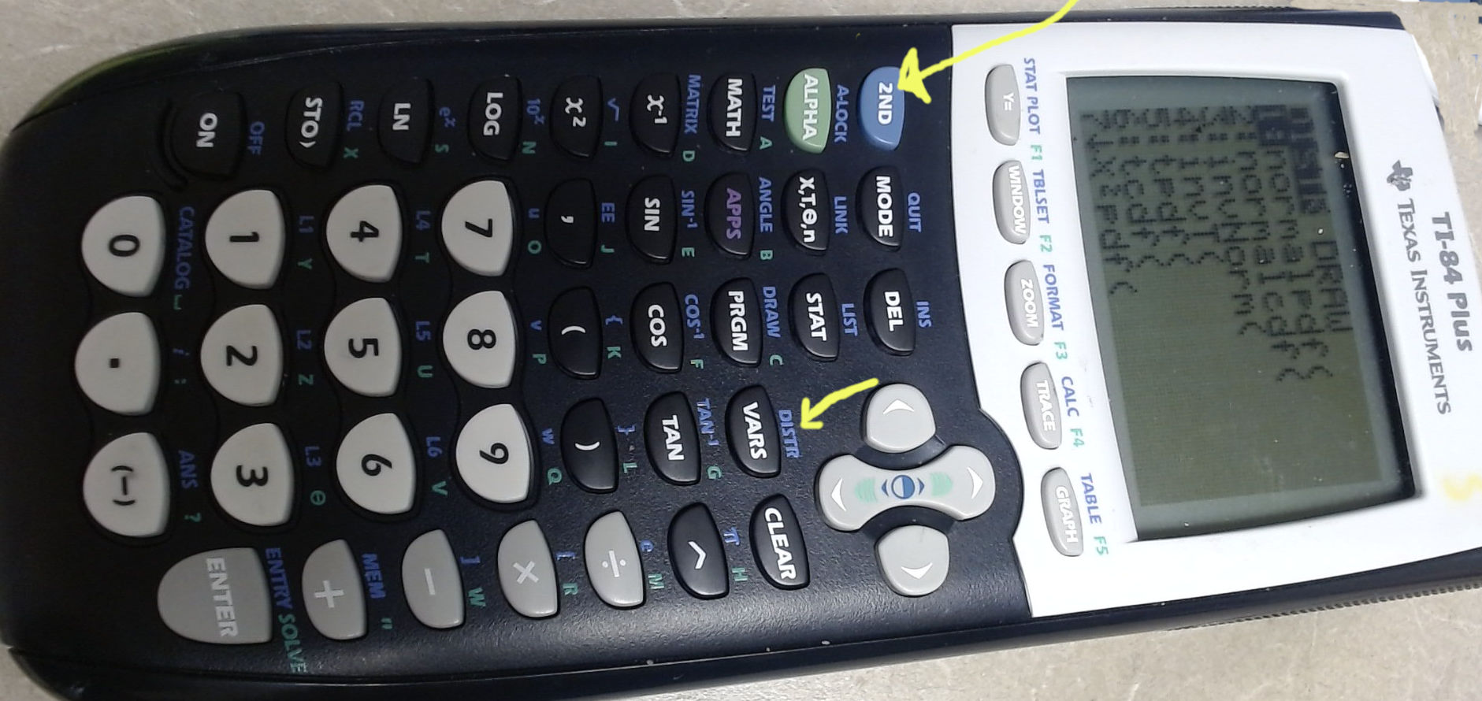
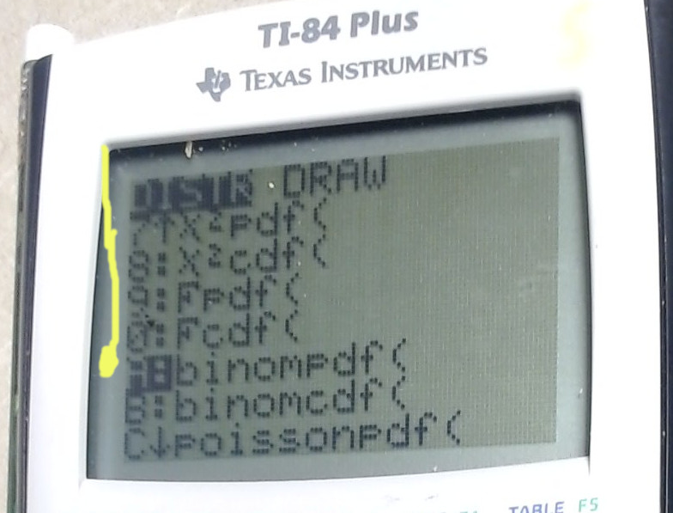
Using the TI-84
Yes, there’s a way to figure these out “by hand” but the TI-84 is programmed to figure it out if you give it the information to put into the formula to figure it out.
How to get there ?
Hold the blue 2nd key
and push the key that
says “DISTR”
Scroll down to ‘binompdf

Slide 4
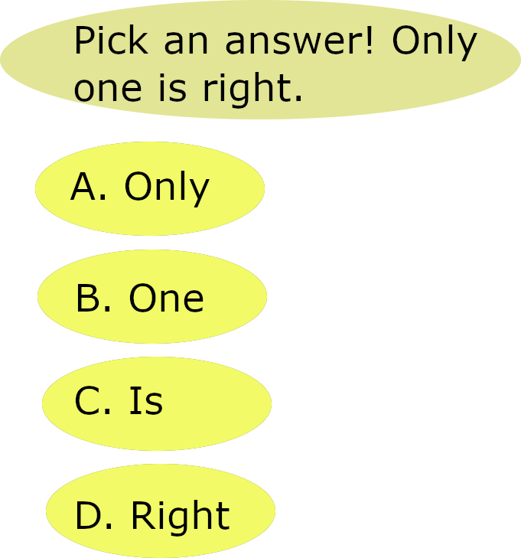
Our binomial situation example
We have a test with 20 questions. There are four possible answers for each question.
The “n” is 20 → that’s how many times we’re asking this question.
The “p” is the probability of getting the “right” answer if it’s random, so it’s 1 out of 4 or 0.25 .
Then we get to the question part.

Slide 5
binompdf
Yes, there’s a way to figure this out “by hand” but the TI-84 is programmed to figure it out if you give it the information to put into the formula to figure it out.
For “binompdf” – you’re finding the probability that this binomial thing happened exactly p number of times.
It’s just *one point* on the list; p for point!
So: “what is the probability that a person will get 11 questions right?” (It doesn’t matter which 11 questions; just 11 out of the 20 but … *exactly* 11.)
Binompdf (20, 0.25, 11) = 0.003

Slide 6
BINOMCDF : Cumulative probability (more than one possibility, added up)
0
1
2
3
4
5
6
7
8
9
10
11
12
13
14
15
16
17
18
19
20
What is the probability of getting 5 or fewer questions right?
So, either 0, 1, 2, 3, 4 or 5 questions right (added all together).
THAT is the question the calculator is set up to answer.
5 or fewer:
Binomcdf (20, 0.25, 5) =.

Slide 7
What is the probability of getting at most 5 questions right?
0, 1, 2, 3, or 4 questions right. It’s another way of saying “5 or fewer.”
Input into the calculator “5 or fewer.”
0
1
2
3
4
5
6
7
8
9
10
11
12
13
14
15
16
17
18
19
20
At most 5:
Binomcdf (20, 0.25, 5) =.

Slide 8
What is the probability of getting fewer than 5 questions right?
0, 1, 2, 3, or 4 questions right.
Input into the calculator “4 or fewer,” so we don’t include 5.
0
1
2
3
4
5
6
7
8
9
10
11
12
13
14
15
16
17
18
19
20
Fewer than 5:
Binomcdf (20, 0.25, 4) =.

Slide 9
What is the probability of getting more than 5 questions right?
6, 7, 8, 9, 10…. Et cetera…
We need to figure out what we *don’t* want and then subtract that from 1.
Since we *don’t want the 5* we include 5 in the “ones that don’t match.”
0
1
2
3
4
5
6
7
8
9
10
11
12
13
14
15
16
17
18
19
20
More than 5
1 - Binomcdf (20, 0.25, 5) =.

Slide 10
What is the probability of getting 5 or more questions right?
5, 6, 7, 8, 9, 10…. Et cetera…
We need to figure out what we *don’t* want and then subtract that from 1.
Since we *want the 5* we back up and ask for “4 or fewer for the “ones that don’t match.”
0
1
2
3
4
5
6
7
8
9
10
11
12
13
14
15
16
17
18
19
20
5 or more:
1 - Binomcdf (20, 0.25, 4) =.

Slide 11
“At least 5” also means getting 5 or more questions right.
The “less than 5 is what we don’t want.
We back up and ask for “4 or fewer for the “ones that don’t match.”
0
1
2
3
4
5
6
7
8
9
10
11
12
13
14
15
16
17
18
19
20
5 or more:
1 - Binomcdf (20, 0.25, 4) =.

Slide 12
What is the probability of getting between 3 and 11 questions right, inclusive?
3, 4, 5, 6, 7, 8, 9, 10, 11
We find the ones we want – 11 or fewer – and subtract the ones we don’t want, which are 2 or fewer.
0
1
2
3
4
5
6
7
8
9
10
11
12
13
14
15
16
17
18
19
20
Between 3 and 11, inclusive:
Binomcdf (20, 0.25, 11) – binomcdf (20, 0.25, 2) =.

Slide 13
What is the probability of getting between 3 and 11 questions right?
Between means not including the borders, so it would be:
4, 5, 6, 7, 8, 9, 10
We find the ones we want – 11 or fewer – and subtract the ones we don’t want, which are 3 or fewer.
0
1
2
3
4
5
6
7
8
9
10
11
12
13
14
15
16
17
18
19
20
Between 3 and 11, inclusive:
Binomcdf (20, 0.25, 10) – binomcdf (20, 0.25, 3) =.
Notes:
We need to add “at least”

Slide 14

Yes, you can download, share, &/or change this if you:
Please attribute to Susan Jones with a link to http://www.resourceroom.net
This work is licensed under https://creativecommons.org/licenses/by/4.0/
This license lets others modify work even for commercial purposes, as long as credit is given to me. See https://creativecommons.org/licenses/ for more information & links to the license deed and legal code.
Notes:
The legal stuff

