Slide 1
Developmental mathematics reform and equity in community colleges: Analysis of recent trends and results Or: What’s the rest of the story?
Susan Jones, M.Ed. Parkland College
Champaign, IL

Slide 2
What is Developmental Education ?
“Developmental education is not a euphemism for remediation …or, it shouldn’t be. (Boylan, 1995) It includes addressing many other factors… social, financial, knowing how to study, college being a fundamentally foreign place
Almost universally, “reform” promotions and research say they are the same. So we’re starting out in a different place.
Notes:
Sue duly notes that this is underplaying the competence and knowledge aspect. If students are coming from poorly funded schools, they’ll be in worse shape.
Also I want visuals here. I need that stupid visual with the

Slide 3
Most promoted dev ed reforms:
The most promoted Dev Ed reforms are:
Multiple measures assessments so more people place at higher levels
Corequisites and other acceleration
Mathematics “pathways” so the math is connected to student goals.

Slide 4
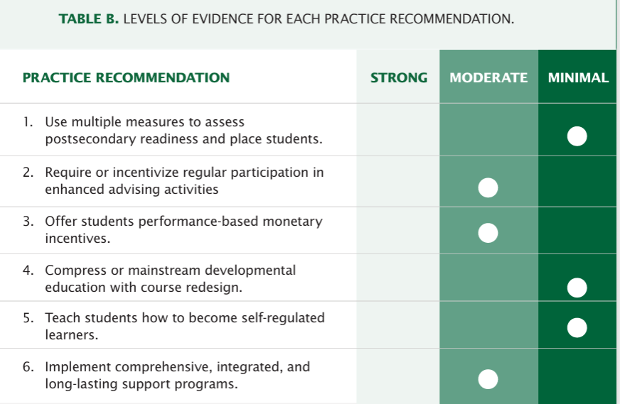
What do they have in common?
They *reduce* the opportunities for learning, especially as remedial courses are eliminated.
They are the recommendations given “minimal” support by the “what works clearinghouse” people.
Comprehensive, integrated and long-lasting support has moderate support. So does getting them lots of “enhanced advising activities” and offering monetary incentives.
Notes:
Thomas Bailey was chair of that panel in 2016.

Slide 5
If *I* could design the reforms?
We’d have LOTS OF SUPPORT. Intensive, intrusive advising. Community Building. Academic and Interpersonal Validation. Financial support and free options. Involvement with community advocacy groups.
Also: What about the math?
Let’s focus on getting people to LEARN MATH. If that happens, they can be successful!
“As fast as you can, as slowly as you must.”
Notes:
If you can, have links to DREAAM and Urbana Connection and First Followers. .

Slide 6
Fault-resistant learning (per Uri Treisman)
If they need the foundations, Start with the foundations regardless of the “pathway,” because pathways can turn into tracking.
Provide many opportunities for legitimate placement into higher level classes.
The ALEKS assessment at many colleges is set up so students have multiple chances to take the adaptive test, and in between can use the ALEKS software to practice the kinds of problems they missed and we could offer walk-in support to help them figure it out.
If you don’t complete a course, you still have the option of applying what you’ve learned to taking that assessment.
Provide community support for improving those skills.
Figure out ways for people to manage interruptions of life and keep learning, and NOT decide that finishing as quickly as possible is the definition of success
.at workship in 2019 Uri Treiseman urged for research specifically focused on the one-third of students who are still not being well served by mathematics reforms.
Notes:
Lakeland College in Illinois eliminated developmental math courses, and designed a new basic college level course. Hey, if you’re going to call the pre-algebra skills college level, I’m on it!!!That said, if you’re going to cram them in and students have to do all the foundations in a hurry and *then*
https://blog.mrmeyer.com/2013/the-fault-tolerant-school/ Increasing Student Success in Developmental Mathematics. (2019). Increasing Student Success in Developmental Mathematics. Washington, D.C. : The National Academies Press. Retrieved from https://nap.nationalacademies.org/catalog/25547/increasing-student-success-in-developmental-mathematics-proceedings-of-a-workshop

Slide 7
Start where they are.
“Deficit thinking” is when we think students have failed because of *their* deficiencies.
Recognizing that they can and should build the foundations – not just get “passed through” as has probably happened before *because of inequities* is the door to building their trust and confidence, especially when we respect their adult thinking.

Slide 8
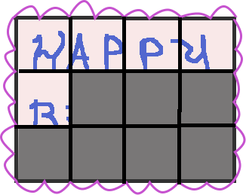
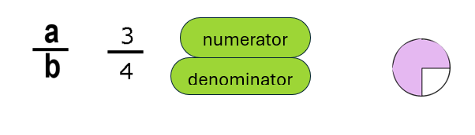
It takes a different kind of teaching.
Teachers who are successful teaching developmental math have figured out that “lecture, they take notes, they learn it, they pass tests” doesn’t work well.
Different teachers do different things: I make LOTS of pictures and teach them why and how to think about things.
Notes:
Brian Cafarella’s dis

Slide 9
Learning happened. Trust happened.
“Is that all it is??????” I went **slowly.** He got things right. Then he got them right faster ;) Then he started asking mathematical questions… in that first lesson.
He went back and talked. The rest of the students …. Started coming. They overcame the barriers.

Slide 10
Learning happened. Trust happened.
“Is that all it is??????” I went **slowly.** He got things right. Then he got them right faster ;) Then he started asking mathematical questions… in that first lesson.
He went back and talked. Another student came up and confided… and literally, I worked w/ him and talked about the test and in half an hour he went downstairs and took it again and got the placement he needed.

Slide 11
They kept coming.
I built the concepts as I’ve been doing here for 20 years.
There were no grades, no quizzes, no tests for formal grades. There was practice – as much as they needed. As fast as you can, as slowly as you must.
We also used ALEKS – they knew they had to improve their score -- but they WANTED TO LEARN and understand.
They could have just come and put in the time and collected the stipend. Not a one did that. When I was working w/ other students, they kept working.
I asked the director what magic he had done. For my folks in classes, often they’re focused on FINISHING THE HOMEWORK, but it takes a while or them to realize that our courses are structured so that taking the time to understand it *is worth it.*

Slide 12
This is where you quote Robin Isserles.
I asked the director what magic he had done. For my folks in classes, often they’re focused on FINISHING THE HOMEWORK, but it takes a while or them to realize that our courses are structured so that taking the time to understand it *is worth it.*
He said he thought it was the money.
I think
Notes:
and One of the impor- tant facets of concerted cultivation is that the children are raised with a sense that they are entitled to ask questions, to interact, to question, even to challenge institutional authority. In my research, as well as among the students I teach and advise, I find that they have not yet developed the confidence, the comfort, or the basic sense that they can and should ask questions and advocate on their own behalf. Much like Lareau found, for so many of the poor and working-class students I have taught and studied, they have learned “to keep their distance from people in positions of authority, to be distrustful of institutions, and, at times, to resist officials’ authority” (Lareau 2002:773)
Moving forward, if we are committed to a more comprehensive notion of student success, we must think much more about whether, and to what extent, we want to disrupt or displace the habitus and life worlds of the students we are hoping to help suc- ceed. When our students maintain deep connections and obligations to their families, to their basic livelihoods, to their multiple roles and identities, it is imperative that we consider how the policies and reform initiatives build upon or break down these connections, and whether the institutions they attend considers and appreciates these conflicts, especially if these connections seem to contradict what we assume to be necessary to succeed academically. The tendency to reduce the def- inition of success to degree attainment is woefully inadequate. At a basic level, what is it that we want for these students (Schor and Freire 1987; hooks 1994)?

Slide 13
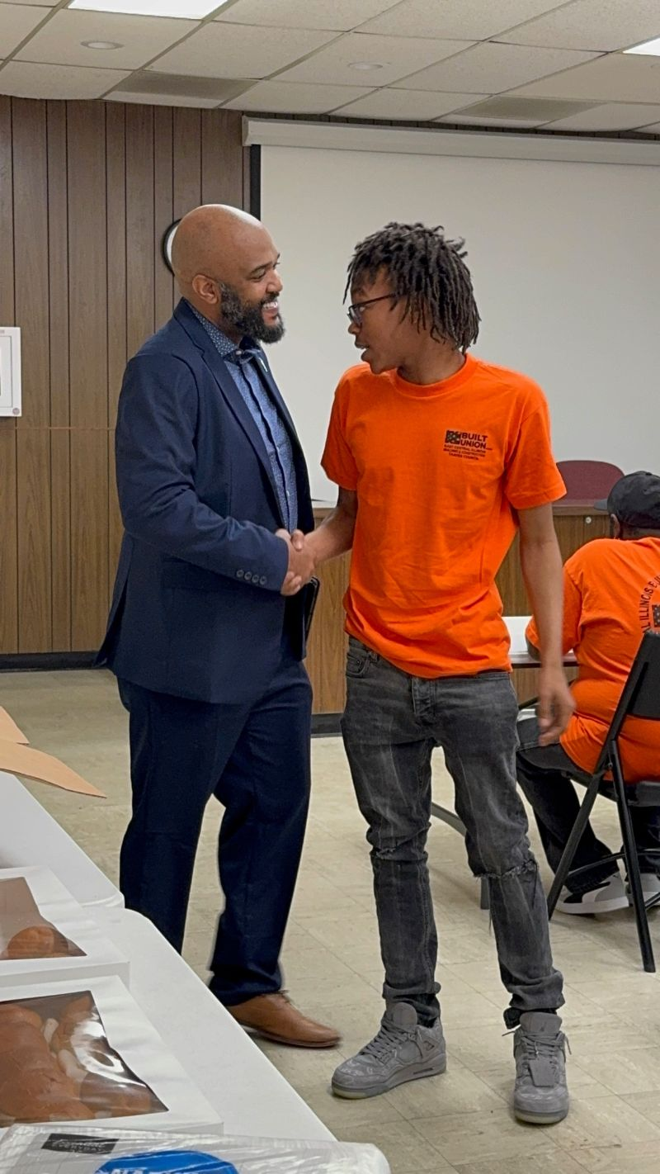
Make it meaningful , with room for acceleration.
There is no need to re-teach from high school courses. We can respect their adult minds and teach the foundations in contexts that make sense, and *teach the thought processes* needed for arithmetic, multiplicative thinking and proportional reasoning – as well as algebra.
We can teach the process of keeping track of different kinds of units, in the context understanding equality, with arithmetic, ratios and proportions. *These* are the skills most needed whether for college math or career preparation.
We can get people onto a pathway – that can go in whatever direction they want!
That’s Jaden, who came for tutoring from our “Apprenticeship Preparation” program, at their graduation with our future mayor. He learned the math and he’s still learning
Notes:
https://ncee.org/what-does-it-really-mean-to-be-college-and-work-ready/ National Center on Education and the Economy, What Does It Really Mean to Be College and Work Ready? The Mathematics and English Literacy Required of First Year Community College Students (Washington, D.C.: National Center on Education and the Economy, May 2013).
Topics:

Slide 14
Corequisites: “I’m the only one who doesn’t get it!!!”
Is it worse to be in a class where it’s a lower level class, or to be in a class where you feel like everybody else knows it better than you – and that’s basically true?
Students need both academic and interpersonal validation, (Baber, 2018)
Notes:
Baber, Lorenzo DuBois. “‘Living in the Along’: Validating Experiences Among Urban Community College Students in a College Transition Program.” Community College Review, vol. 46, no. 3, 2018, pp. 316–40, https://doi.org/10.1177/0091552118775813

Slide 15
Oh, we do a lot of this at Parkland College.
Our Pre-Algebra course has conceptual, mindful units in integers, fractions, decimals, and ratios and proportions, They are *all* designed to align with what students need to understand for different certificate, career, and transfer paths. Almost all students place at least this high.
YES, students start here and graduate, and transfer.
There are many doors opened.
Business math and technical math, the requirements for many certificates and associate’s degrees
Several health care certificates
If a student earns an A or a B, they are eligible for co-requisite Statistics.
Students can take Math 072 – Math Literacy – as a prerequisite for Statistics.
They can usually also take the assessment again.

Slide 16
We could use more support, though!

Slide 17
The “reform research” and press releases: developmental = remedial.
“Developmental education, sometimes referred to as remedial education, is designed to develop foundational knowledge in reading, writing and mathematics… (50 state comparison of dev. ed. policies)
Hence it was not surprising that many colleges turned to developmental education, or remedial courses for underprepared students. Bickerstaff, S., Melguizo, T. 2024)
…remedial classes, also known as developmental classes (Hanford, 2016).
There are many, many more.
Notes:
long version
https://www.ecs.org/50-state-comparison-developmental-education-policies-2025 “ Developmental education, sometimes referred to as remedial education, is designed to develop foundational knowledge in reading, writing and mathematics for students whom the institution deems underprepared for college-level course work based on placement policies and readiness assessments.” No, they are not the same.
Hence it was not surprising that many colleges turned to developmental education, or remedial courses for underprepared students. Source 5, page 8.
But when she went to enroll at her local community college, a counselor said she had to take a placement test. When the results came back, Gandy was told she needed remedial classes… It was a huge blow. Financially, because remedial classes, also known as developmental classes, cost money but don't count as credit toward a degree. Source 6 PARAGRAPH 5 (so don’t *quote* it, okay?) GO TO CONFLATION PPT

Slide 18
What is Developmental Education Reform ? Is it working? Is it worthwhile?
The enthusiastically promoted developmental education reforms define the “problem” to be reformed: too many students are not completing the developmental courses, not completing college level courses, or earning credentials. This is a valid critique! But then the spin begins.
It’s all about *time!* It’s a “completion crisis,” because community colleges don’t have high completion rates compared to … colleges with different populationsand different goals. This really isn’t fair. (Bragg, D.D. & Durham, B. 2012)
As these reforms have been implemented, they have defined “success” more and more narrowly, as their reforms have not demonstrated long-term improvement for completion of credentials.
Notes:
Of course, since this is *their* agenda, it shouldn’t be eliminated. They just need to improve the implementation! – a double standard.
Bragg, D. D., & Durham, B. (2012, May 6). Perspectives on Access and Equity in the Era of (Community) College Completion. Community College Review. Retrieved from https://journals.sagepub.com/doi/full/10.1177/0091552112444724​

Slide 19
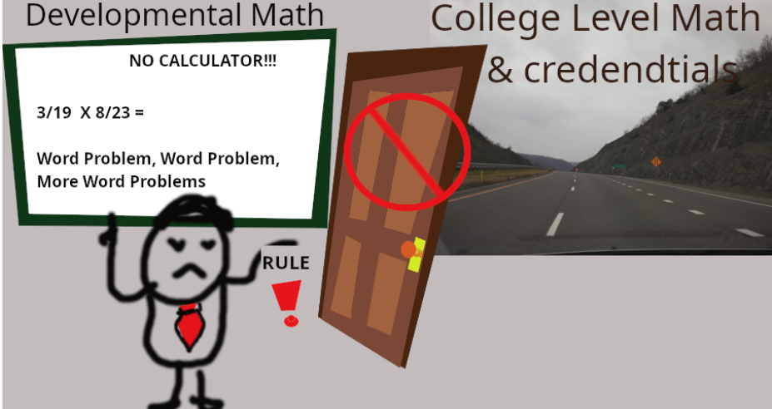
Notes:
The develeopmental math we need to reform: Blocking that door to that smooooth road to college level math!!! That’s their picture.

Slide 20
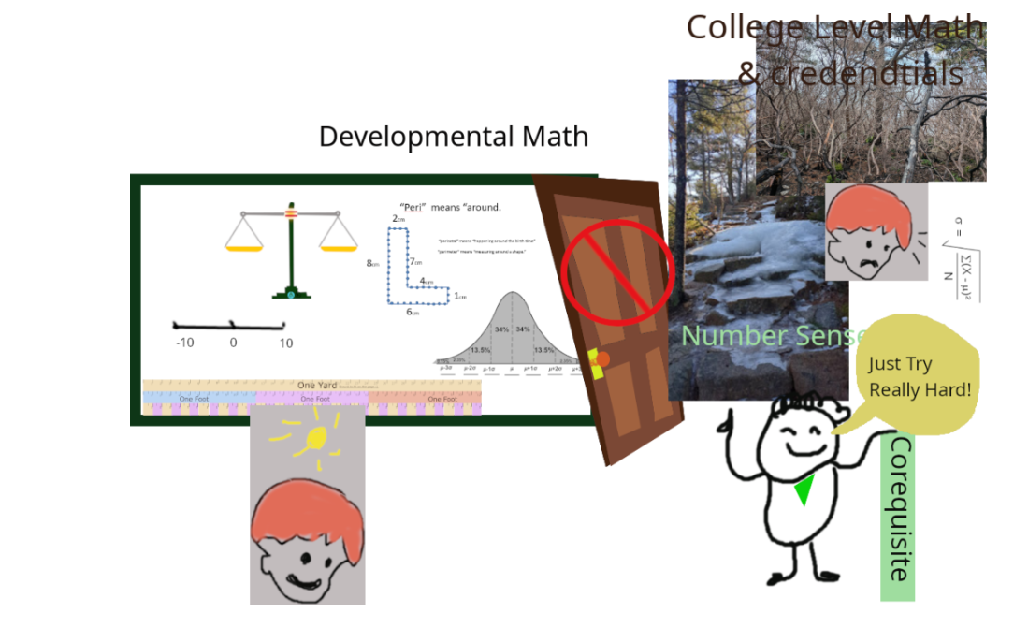
Notes:
A different perspective: the reformers want to close the door and send the dev ed student up an icy path to a stress-filled future where only a few more of them will succeed – and more people just drop out.
No, these memes aren’t the best but I don’t have the Gates Foundation funding a graphic designer.

Slide 21


Benefactors, old & new
Supporting think tanks, contract research firms, nonprofit consultancies, with negative views. "REFORM!"
Supporting research and scholarships, with positive views of the colleges
Always with a smile, because they’re so happy to “serve.”
Notes:
Now, these folks are relatively new “benefactors’ to postsecondary education. Robin Isserles, in her _Costs of Completion_ book, analyzes trends in foundations and benefactors providing financial support to postsecondary institutions. Groups like the Kellogg Foundation and the Carnegie institute would provide support with scholarships, and research done *at the colleges,* with a positive view of the colleges and their efforts.
Our new edu-philanthropists, such as the Bill and Melinda Gates foundation and Lumina Foundation, espouse *reform* with very strong, negative views, and much of the funding goes to think tanks, contract research firms, and nonprofit consultants. At best, it’s an echo chamber.

Slide 22
Negative bias examples?
Complete College America’s Remediation: Higher Education’s Bridge to Nowhere
The title is just the beginning. It’s rife with “dropout exit ramps” and “dead ends.”
*Even in this article,* they state that their reforms will work for “as many as half” of developmental students.
Yes, that’s been around a while – but in case we forgot Brandon Postas posted an op ed in the Hechinger Report with a link, repeating the negativity, in November 2024.
There are enough examples of this that folks have done dissertations about the narratives.
And yes, they really do want to *eliminate* developmental education courses. California, Illinois, Texas, Tennessee and Florida have all radically reduced or eliminated developmental education courses.
Notes:
Brandon *was in the zoom meeting* with me in March saying this. pdate: Report on Innovations in Developmental Mathematics - Moving Mathematical Graveyards
Merseth, Katherine K
. Journal of Developmental Education
; Boone Vol. 34, Iss. 3, (Spring 2011): 32-33,36-38.
They have claimed to me that they have “evolved” in their opinion of developmental education but in November 2024, Brandon Postas posted an op ed reciting the same claims with a link to the article.

Slide 23
Negative bias?
Developmental education… is… for students whom the institution deems underprepared for college-level course work based on placement policies and readiness assessments.”
“The problems w/ dev ed are both long-standing and national in scope. Many states have been struggling to find ways to reduce or eliminate developmental education as we now know it, with varying degrees of success.”
When the results came back, Gandy was told she needed remedial classes… It was a huge blow. Financially, because remedial classes, also known as developmental classes, cost money but don't count as credit toward a degree.
Title of the story? “Stuck at Square One.” (It does include caveats and defenses of remedial learning later in the story.)
((there are many, many more.))
Notes:
Notice they are *not* even mentioning addressing the problem of inequities in the opportunities students have to learn math so that they could succeed in college level math courses.

Slide 24
Hmmm… do they really mean *remove* remedial courses?
Again, more doublespeak. “I want to close with an important clarification: the corequisite model is not about eliminating remediation.” This article about replacing pre-requisites with co-requisites in Tennessee, which I’ll explore in a minute, is about “most exciting” results of placing all students at all levels in college level courses. In other words, removing remedial course options.
“Replacing Prerequisite Remedial Courses With Corequisite Courses and Other Types of Concurrent Support” is a goal for Just Equations, also in the name of equity.
In “Developmental Education Reform in Illinois,” Joe Saucedo declares that removing remedial courses is a “racial equity imperative.”
Notes:
. https://maa.org/math-values/supporting-students-across-readiness-levels-in-corequisite-models/Xiaotao Ran, F. X., PhD. (n.d.). Supporting students across readiness levels in corequisite models – Mathematical Association of America. Mathematical Association of America. Retrieved March 29, 2025, from https://maa.org/math-values/supporting-students-across-readiness-levels-in-corequisite-models/
https://occrl.libsyn.com/developmental-education-reform-in-Illinois
When I sent an email citing research and asking if he had considered that, he replied that he is no longer involved in that project. What does that say?

Slide 25
Yes, states really are doing this.
California (Bickerstaff & Melguizo, 2024) and Illinois (Illinois General Assembly, 2021) -- laws emphasizing completion of transfer level coursework in the first year, regardless of the level of student need.
Florida - no prerequisites for gateway college courses
Many other states are in various stages of the process of regulating developmental ed. The decisions are being made by people who are not working with the students.
These organizations claim to be listening to “resistant” school faculty, staff and administrators, but then dismiss them (often in the same sentence).
Notes:
States such as California (Bickerstaff & Melguizo, 2024) and Illinois (Illinois General Assembly, 2021)have passed laws requiring schools to “maximize the likelihood” that students will “enter and complete transfer-level coursework in English and mathematics/quantitative reasoning in a one-year time frame,” regardless of the level of student need. Florida has eliminated prerequisites for gateway college level courses (Florida Developmental Education Reform: How Colleges are Paving Pathways to Student Success, 2016). Many other states are in various stages of the process of regulating how schools design and deliver courses and support to underprepared students (Hodges, et al., 2020). These organizations claim to be listening to “resistant” school faculty, staff and administrators, but It’s important to get beyond often oversimplified reports and look more deeply at results to discern patterns indicating inequities may be being exacerbated, not ameliorated.

Slide 26
Attewell references MAYBE
https://justequations.org/blog/math-as-a-gatekeeper-examining-the-evidence if we have time and find the analysis of that article because Bettinger and boatman also iirc just selectively grab him. Though boatman is the one who says good things about it for lower levels.
Notes:
https://justequations.org/blog/math-as-a-gatekeeper-examining-the-evidence

Slide 27
Let’s talk aout equity.
If education is “equitable,” then all students have opportunities to learn and succeed with fairness, impartiality, and justice.
THEIR STORY: The California Acceleration Project (2022) states: “When a placement system is equitable, Black and Hispanic students place and enroll in transfer-level math at the same rate as other groups.”
This falsely assumes they have had equitable opportunities in their previous experience.
This denial of real need to learn foundations of math skills is common and it exacerbates inequities as students are expected to make up the gap while also trying to learn the advanced material.
Notes:
Seems they’re deniying the inequities?

Slide 28
Do they know the math?
Their story:
Students are “deemed” underprepared.
From Complete College America podcast – it’s our mindset that says they’re underprepared, but they’re not! (saying that students might have gotten to Calculus but forgotten things, or that they will have been managing the household budgets.)
I guess they’ve never met people who’ve struggled with basic math all their lives.
No, they don’t have research to support this.

Slide 29
What does the research say?
Some examples of just how students get into developmental math, and why they aren’t successful, (among more):
Work habits along with severe underpreparedness (Cafarella, 2016)
In adult education: mismatch between the student’s current mathematical ability and the level for which the curriculum was designed (Showalter, 2014)
Time delay from previous math course and lack of basic math skills (Zientek, 2014).
Regarding “but they did well in high school!” Paul Nolting notes that high school grades are often a measure of effort and attitude. (Boylan, 2011)
One study stated that as many as 1/3 of students were misplaced into developmental education courses **when a single test score was used for placement** -- we can fix that! -- and if 2/3 of them are accurately placed, why eliminate developmental courses?
Notes:
Cafarella B. Developmental Math: What's the Answer?. Community College Enterprise [serial online]. Spring2016 2016;22(1):55-67
Showalter D, Wollett C, Reynolds S. Teaching a High-Level Contextualized Mathematics Curriculum to Adult Basic Learners. Journal Of Research & Practice For Adult Literacy, Secondary & Basic Education [serial online]. Summer2014 2014;3(2):21.
Zientek L, Schneider C, Onwuegbuzie A. Instructors' Perceptions About Student Success and Placement in Developmental Mathematics Courses. Community College Enterprise [serial online]. Spring2014 2014;20(1):67-84.
Boylan H. Improving Success in Developmental Mathematics: An Interview with Paul Nolting. Journal Of Developmental Education[serial online]. Spring2011 2011;34(3):20-27.

Slide 30
Stigler’s research: what do they understand?
Basically anything that expected figuring out what a question meant
Examples:
Adding a simple fraction to a decimal. 19% got it right;
Ordering 4 numbers (two simple fractions & two decimals)
Adding 2 squares under a radical
Finding a missing length for 1 of 2 similar triangles
Finding the percent increase of 2 dollar amounts
They *did* get the 10 questions right that were in totally expected formats. Unfortunately college level math expects understanding.
Notes:
Here’s some actual research into what the students know. And the teachers know this. This study
Stigler, J.W. et al. (2010) What community college developmental mathematics students understand about mathematics. MathAMATYC Educ. 10, 4–16
The 10 problems

Slide 31
Folks, it’s not that they “forgot a few things but they understand it.”
Also, in interviews, students regarded math as a set of procedures to be memorized, and that’s how it was taught.
Yes, that’s a problem with many remedial math courses, but that’s the problem, not the fact that they exist.

Slide 32
My favorite quote from that article:
Currently there is great interest in reforming developmental mathematics education at the community college. Yet, it is worth noting that almost none of the reforms have focused on actually changing the teaching methods and routines that define the teaching and learning of mathematics in community colleges.

Slide 33
Yes! The reformers sometimes address this regarding the college level courses
However, if students don’t have the basic understanding, then teaching higher levels conceptually is essentially what Zaretta Hammond calls “cognitive redlining.” It is *not* accessible to students who’ve not had the opportunities to understand fractions and decimals conceptually, much less proportional reasoning.

Slide 34
Reformers claim: “Dev ed isn’t working!”
The research being used to justify the negative narrative invariably includes caveats and limitations, which are generally ignored.
For instance _New Evidence on College Remediation_ is often cited as evidence of how ineffective developmental education is. However, if you read the whole article, it states that when student background and preparation are taken into account, remedial courses are, in fact beneficial at two-year colleges. If students pass the courses, they are even more likely to succeed than the students who didn’t start with remedial courses.
Notes:
Attewell, Paul A., et al. “New Evidence on College Remediation.” The Journal of Higher Education (Columbus), vol. 77, no. 5, 2006, pp. 886–924, https://doi.org/10.1353/jhe.2006.0037

Slide 35
Examining the “Successes” cited: Logue, et al
"Should Students Assessed as Needing Remedial Mathematics Take College-Level Quantitative Courses Instead? A Randomized Controlled Trial.“
When Alexandra Logue tweeted the link, I was skeptical – but this truly *was* research with relatively random selection and a control group. It was *analyzed.* And W and INC were considered “not passing.”
The folks in the stats class had best results…
But… there are howevers.
Notes:
These are the programs often cited as justification "Should Students Assessed as Needing Remedial Mathematics Take College-Level Quantitative Courses Instead? A Randomized Controlled Trial."Alexandra Logue tweeted that hey, there was lots of evidence that supporting students in college level math *worked* with a link to a study: "Should Students Assessed as Needing Remedial Mathematics Take College-Level Quantitative Courses Instead? A Randomized Controlled Trial."

Slide 36
Most “skip remedial” reform options do not have that level of support.
They screened out the lower scoring students (they have another program for that).
Comparing folks going into statistics to folks going into the Calculus track isn’t a true parallel. Shifting to statistics might have been the factor that led to the improvement.

Slide 37
Who fell through the cracks?
According to Jill Barshay in Hechinger Report:
50% boost in the number of students completing A.A. degree in 3 years – but that improvement was to 25%. 75% of the students *didn’t.*
100% increase in the number of bachelors degrees – all the way to 14%.
In the *long run,* → seven years instead of 3 – results still good but degree completion caught up.
In 2020, “Examining the Academic Effects of Developmental Education Reform : Faculty Perceptions from a Large, Public, Urban Univeristy” – about CUNY -- 140 faculty were surveyed and there were serious concerns about course quality when trying to teach students who were so much less prepared, and other concerns.
It is, simply, not a panacea and shouldn’t be the only option.
Notes:
Barhshay, Hechinger Report
College Readiness in
Post-Remedial Academia:
Faculty Observations from
Three Urban Community
Colleges
Lane, C., Schrynemakers, I., & Miseon, K. (2020). Examining the Academic Effects of Developmental Education Reform: Faculty Perceptions from a Large, Public, Urban Univeristy. The Community College Enterprise, pp. 27-57.

Slide 38
What about California, Texas, Illinois….
The claims of success pretty universally:
Only compared students who *almost* qualified for college level
State the “percent improvement” → not the actual success rates.
When Black students “improve” their completion from 7 to 12%, that sounds like we still need more options.
Graphs didn’t go up to 100% … which our math literacy course teaches is deceptive.
They’ll call these “equity gains” – even when the gaps are actually wider after the “improvements.”
Yes, I have examples.

Slide 39
Texas: College placement is better!
The Impact of Corequisite Math on Community College Student Outcomes: Evidence from Texas
Short term benefits, but no improvement in completion
ONLY students at the top of 3 levels of remediation need were included in the study.
It’s cited in this article about the “strengths and challenges” of corequisite dev ed in Texas, which states that some faculty think some students need prerequisites but that no, they don’t!! Since the study excluded exactly the “some students” the faculty were talking about, this is disingenuous.
Notes:
A Texas study inspired me to collect these studies and articles, when they claimed interventions were successful because of imprAkiva Yonah Meiselman, Lauren Schudde; The Impact of Corequisite Math on Community College Student Outcomes: Evidence from Texas. Education Finance and Policy 2022; 17 (4): 719–744. doi: https://doi.org/10.1162/edfp_a_00365ovement – and more than 90% of students were still failing. This is the standard practice. https://postsecondaryreadiness.org/strengths-and-challenges-corequisite-developmental-education-texas/
https://postsecondaryreadiness.org/strengths-and-challenges-corequisite-developmental-education-texas/
Have I mentioned that being disingenuous is a pattern?

Slide 40
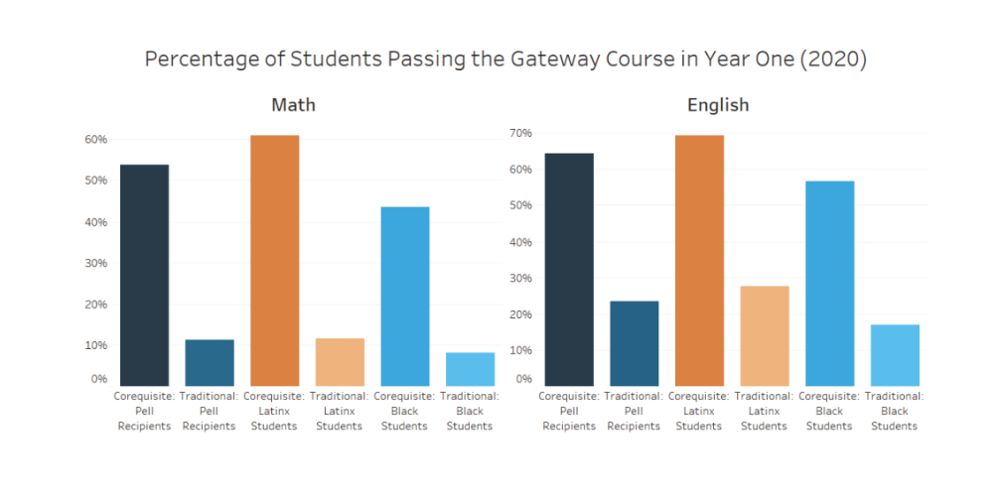
Illinois: Co-req is better!
It says corequisites are “unparalleled.”
In a podcast at the University of Illinois, we were told that they would “listen” to “resistant” faculty, but that removing remedial courses and replacing them with co-requisites are a “racial equity imperative” with a single example, of a 4-year privat college, improving success rates.
Notes:
First, notice that the chart doesn’t go to 100% . In our Math Literacy course – a developmental ed course that we’re expected to eliminate – students are taught that this is misleading. How many students are we failing? They are *not* disaggregated by skill level. Could it be that the students we’re failing came in without the knowledge base to succeed?
https://partnershipfcc.org/publications/a-progress-report-on-reforming-developmental-education-in-illinois/ Saucedo, J., & Roe, L. (2o24, July 29). Developmental Education Reform in Illinois. Democracy's College, Episode 57. (S. Bennett, Interviewer) Retrieved from https://occrl.illinois.edu/docs/librariesprovider2/podcast/episode-57-developmental-education-reform-in-illinois.pdf

Slide 41
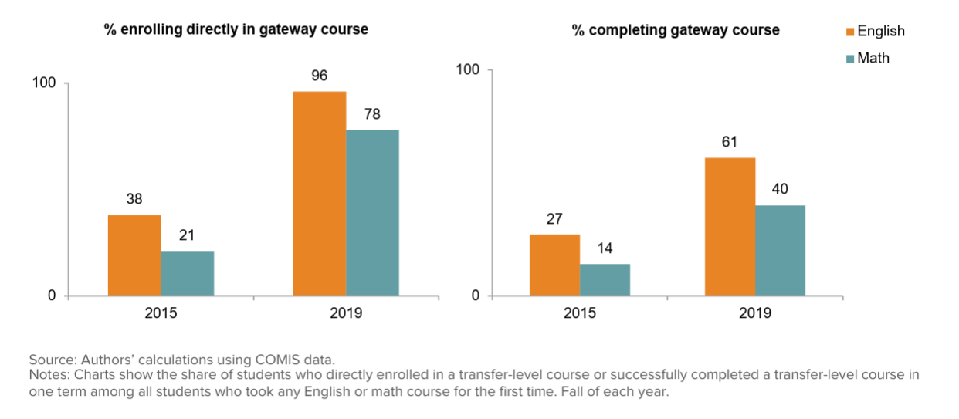
Co-req is better!! California!! "new era of student success at California Community Colleges"
It also states that equity gaps persist and … they need to address the needslof lower level students. How about “teach them what they need to know” ?
Notes:
"new era of student success at California Community Colleges" It’s not the percent of students; it’s the percent of students taking any English or Math course for the first time.
The completion *rate* -- comparing enrollment to completion -- for math is lower.
The completion is 40% -- less than half.
It notes that equity gaps persist *and* needs of lower entry level students need to be addressed (without asking whether they would benefit from a pre-requisite course).

Slide 42
And Florida, too…
“Florida Colleges Meet Developmental Ed Challenge ” cites “modest success.” It is “improving equity in outcomes.” This is based on more students passing the college level courses when prerequisites were eliminated. The pass rates dropped significantly. (Again, no disaggregation regarding level of preparedness.)
OH, and while more students passed…
Notes:
https://www.ccdaily.com/2020/01/florida-colleges-meet-developmental-ed-challenge/

Slide 43
“Equity gains”
Compared with students in previous cohorts, a larger share of students in the FCS entering cohorts since fall 2014 have passed their gateway courses, indicating that there are now greater shares of students taking and passing gateway courses. Gains have mostly been larger for Black students (from 7 to 12 percent in math and 33 to 48 percent in English) and Hispanic students (from 14 to 21 percent in math and 46 to 57 percent in English) than for White students (from 16 to 21 percent in math and 50 to 56 percent in English).
So… fewer than 1 in 8 Black students passed. They call that equity? What if some of the other students needed a remedial course?
Notes:
https://postsecondaryreadiness.org/florida-developmental-education-reform-equity/

Slide 44
The folks working with the students?
It hasn’t gotten worse, but I don’t see that it’s much better … As a state, have we saved a lot of money? … As a taxpayer, rather than an educator, I would say if it’s not gotten any worse and we save $5 million, then it worked.
Forgive me for not considering that “reform.” There were rather many more examples of shortcomings.
Notes:
Mix AN, Jones TB, Brower RL, Hu S. Equality, Efficiency, and Developmental Education Reform: The Impact of SB 1720 on the Mission of the Florida College System. Community Coll Rev. 2019;48(1):1-22. doi: 10.1177/0091552119876327. Epub 2019 Sep 27. PMID: 32801401; PMCID: PMC7413031.

Slide 45
Other faculty considerations:
” Works really well for some students, but it’s totally unfair to so many other students.” “We have some students that simply have gaps in their math knowledge, and they don’t need as much instruction, but we also have so many low level students, and it’s not fair to push them this far.” (Cafarella, 2016)
Student learning: they don’t have time to digest material. (Saxon, 2017)
Notes:
Cafarella B. Acceleration and Compression in Developmental Mathematics: Faculty Viewpoints. Journal Of Developmental Education [serial online]. Winter2016 2016;39(2):12-25. https://files.eric.ed.gov/fulltext/EJ1117729.pdf
Saxon D, Martirosyan N. NADE Members Respond: Improving Accelerated Developmental Mathematics Courses. Journal Of Developmental Education [serial online]. Fall2017 2017;41(1):24-27

Slide 46
Wait, wait! Tennessee. “Works for all levels!!” https://maa.org/math-values/supporting-students-across-readiness-levels-in-corequisite-models/
When students didn’t take remedial courses, more of them passed a college level course in the first year *across all levels.*
In the low-scoring prerequisite cohort, *fewer than 5 %* enrolled in a gateway course in the first 2 terms (because they were taking the remedial courses). This is being compared to a cohort who could enroll directly. It wouldn’t be very hard to have improvement! It would almost be a mathematical impossibility not to!
The other significant result: significantly more attrition -- *at all levels.* This has been noted in other research and settings about co-requisites, including speculation that reported “success rates” may be inflated because of this.
Notes:
This article has been posted at least half a dozen times on LinkedIn by the likes of the Dana Institute and assorted individuals. It’s just one more example of so many of putting a very hard spin on the information to make it look positive, and I’m afraid to say it might fool some of the administrators and people who don’t actually work with students. You know, the ones making these “co-req for all!” laws. I emailed the author to confirm my interpretations.
https://ccrc.tc.columbia.edu/media/k2/attachments/effects-corequisite-remediation-tennessee.pdf the longer article

Slide 47
What are other scholars saying?
The notion that remedial courses are, somehow, in and of themselves a barrier (implied and stated implicitly by many of the organizations promoting corequisites), is challenged, especially when other barriers such as K-12 inequities are ignored. (Goudas and Boylan, 2021, Wood, J.L, 2012 )
Consistently, when student preparation is accounted for, remedial courses benefit, not harm students. (Bahr, 2008, Attewell 2006, Boatman and Long, 2018)
Notes:
Goudas, Alexandras M., and Hunter R. Boylan. “Addressing Flawed Research in Developmental Education.” Journal of Developmental Education, vol. 44, no. 3, 2021, pp. 4–33. JSTOR, http://www.jstor.org/stable/45381112. Accessed 29 Mar. 2025.
Wood, J. L. (2012). From the Right to Fail to the Right to Succeed: Black Males in Community Colleges. About Campus, 17(2), 30-32. https://doi.org/10.1002/aca.21078 (Original work published 2012)
Boatman, A., & Long, B. T. (2018). Does Remediation Work for All Students? How the Effects of Postsecondary Remedial and Developmental Courses Vary by Level of Academic Preparation. Educational Evaluation and Policy Analysis, 40(1), 29–58. https://doi.org/10.3102/0162373717715708
Bahr, Peter Riley. “Does Mathematics Remediation Work?: A Comparative Analysis of Academic Attainment among Community College Students.” Research in Higher Education, vol. 49, no. 5, 2008, pp. 420–50, https://doi.org/10.1007/s11162-008-9089-4.

Slide 48
Alternatives to removing learning opportunities
Guiding students to the right math course really helped!
That could apply to “remedial” courses, too.
Students can still accelerate!
We can redesign the instruction! (That would be a whole other presentation.)
Notes:
It was also noted in several reports that guiding students to take math courses more closely aligned to their career goals was a critical driver of the positive effects. What if, for students who demonstrate the need for it, that same guidance could be applied to developmental coursework, designed so that students could accelerate if that meets their needs, but with built-in flexibility for students with more complex needs? Other aspects of the co-requisite placement included academic and non-academic support, and changes in instructional design. These could also be applied to developmental courses. Most of these studies did not include applying best practice principles to developmental math courses as an option.

Slide 49
Yes, we need to address math education inequities.
Developmental education courses aren’t the source of the inequities.
Designing policies as if they are – as is happening -- *prevents us* from addressing the real sources.
Let’s recognize that many students have more than “modest” needs, so *going faster* may be the worst strategy.
Let’s Open doors and opportunities, not close them!

Slide 51
To wit:
We found no significant impacts of placement into corequisite remediation on enrollment persistence, transfer to a four-year college, or degree completion. This suggests that corequisite reforms, though effective in helping students pass college-level math and English, are not sufficient to improve college completion rates overall
You would not get this impression from the Tennessee board of Regents’ PDF about “Gaining Momentum.
Notes:
https://www.tbr.edu/sites/default/files/media/2021/11/GainingMomentumExecutiveSummaryNovember%202021.pdf

Slide 52
Okay, the totally stupid logic which we need to visually represent.
The idea that “Colleges with relatively lower levels of access have larger racial inequities in transfer-level enrollment, particularly in math.”
Racial inequities before college mean that these students are arriving less prepared. There’s rather a lot of evidence that when students start a class with better preparation, they’re far more likely to succeed. (Attewell, 200This is what I need the evidence for. https://www.ppic.org/publication/a-new-era-of-student-access-at-californias-community-colleges/ attewell has it.
Notes:
Attewell, Paul, et al. “New Evidence on College Remediation.” The Journal of Higher Education, vol. 77, no. 5, 2006, pp. 886–924. JSTOR, http://www.jstor.org/stable/3838791. Accessed 29 Mar. 2025.

Slide 53
Citations
Boylan, H. R. (1995). Making the case for developmental education. Research in Developmental Education, 12(2), 1-4
https://www.ecs.org/50-state-comparison-developmental-education-policies-2025 need citation do NOT have it yet ‘cause this is verynew.
Source 5 Bickerstaff, S., Melguizo, T. (2024). Developmental Education Reform as a Civil Rights Agenda: Recent History and Future Directions for California. Los Angeles, CA: The Civil Rights Project/Proyecto Derechos Civiles, UCLA.
Source 9: Quarles, Christopher L. and Mickey Davis. "Is Learning in Developmental Math Associated with Community College Outcomes?." Community College Review, vol. 45, no. 1, Jan. 2017, pp. 33-51. EBSCOhost, doi:10.1177/0091552116673711.
Hanford, E. (Aug. 18, 2016). Stuck at square one: College students increasingly caught in remedial education trap. American Public Media Reports. Available from https://www.apmreports.org/story/2016/08/18/remedial‐education‐trap source six

Slide 54
REALITIES: attrition THIS IS WHERE THEY ADMIT IT
12
15
Early in adoption: seeing a lot of attrition, students just dropping the classes.
“but in the grand scheme of the data, it’s showing better outcomes than what we had been seeing prior. “
Notes:
This is from the Just Equations

Slide 55
Supporters of dev ed
McCabe, R. (2000). No one to waste: A report to public decision-makers and community college leaders. Washington, DC: American Association of Community Colleges, Community College Press.
Notes:
Fyfe, E. R., Matthews, P. G., & Amsel, E. (2020). College developmental math students’ knowledge of the equal sign. Educational Studies in Mathematics, 104(1), 65–85. https://doi.org/10.1007/s10649-020-09947-2

Slide 56
“CO-REQS ARE GREAT!!!” with … so *many* caveats…
The Strengths and Challenges of Corequisite Developmental Education in Texas: states that faculty wanted co-requisites as an option, but that some students needed to build skills. It stated this was “not supported” by research, linking to an article specifically stating that they had *only* researched students who were at “level

Slide 57
“I just never got math, but now I want to.”
Last fall, the director of a new Apprenticeship Readiness program approached me. So many students applied, but didn’t do well enough on the assessment test to qualify for the program. This semester was a “bridge” to get them ready.
There were two levels of”ready” depending on which career track.
They built in tutoring with me into the program; they’d do the morning session, then… my lunch was 12:00-1:00 so they’d come to me at 1:00 for tutoring and they would sign in, because they would be *paid for these hours.*
No. One. Came. The first week. Not a soul. They were “busy.” They all had reasons.
Then … Jaden (I have his consent to talk about him) came. We figured out the logistics of the computer practice. He confided that no, he didn’t understand math.
Notes:
Story time!

