Slide 1
Developmental mathematics reform and Math: What is progress?
Susan Jones, M.Ed.
Parkland College Learning Commons
Champaign, IL
Notes:
(Introduction: I work with developmental education students at Parkland College and have collaborated with instructors to design materials and experiences to build foundation concepts starting from wherever they are starting.) l

Slide 2
Clarification
The opinions expressed here belong solely to me and reflect my experiences as college staff providing student support services and do not reflect the views of my employer, Parkland College.

Slide 3
“Developmental Education Reform Act”
2021
Developmental education reform laws require schools to “maximize” the chances of finishing college Math and English courses in their first year.
Notes:
In 2021, The Developmental Education Reform Act was passed. They claim it “centered dismantling systemic racism across multiple sectors, including in education andworkforce development.” The meat of the law:
Schools are required to to “maximize” the chances of finishing college Math and English courses in their first year. I’m going to focus on Math.

Slide 4
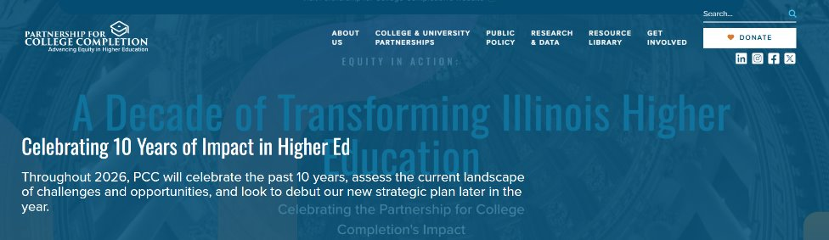
Illinois'
"Partnership for College Completion"
Notes:
The Illinois' Partnership for College Completion promotes these reforms. PCC’s stated goal is to address disparities in college access by race and income, along with persistent and widening racial and socioeconomic disparities in college degree completion. They've published several "progress reports" about developmental education reform.
If we examine them, we see a very different focus: to eliminate developmental education and replace it with co-requisite college level courses.

Slide 5
The realities
The actions taken in the name of equity, to purportedly "maximize" success, in fact:
  Deny K-12 inequities in preparation for college
  Remove opportunities for making up for those inequities
  Encourage different “pathways,” requiring less demanding math skills. How is this different than “tracking” ?
  Want *less* use of standardized tests
Notes:
goals are consistent with:
denying the very real inequities in our K-12 schools for preparation for college, especially in Math.
They want to remove opportunities to build competence and confidence;
They encourage “pathways” with less demanding math skills.
“Success” is – finighing either English or math the first year. That’s it.
They don't look at statistically comparable populations to support that co-requisites are better.
They don’t look past the first year or at other indicators of academic success.
They want less use of standardized tests – a major source of accountability.

Slide 6
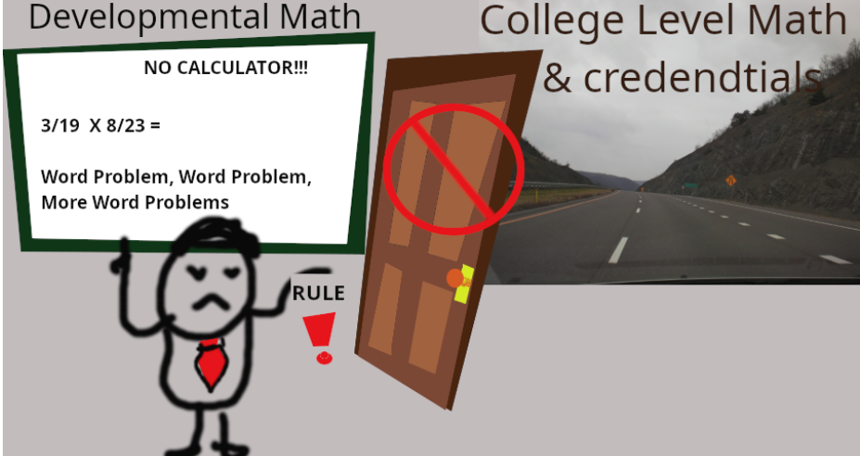
The "reformers" view: The *courses* are the barrier and they are boring and irrelevant!
Notes:
The develeopmental math we need to reform: Blocking that door to that smooooth road to college level math!!! That’s their picture. They’ll say – anecdotally – that students “just need a little review”… that they *took* Calculus but forgot some.
That is simply not a realistic picture. The unspoken part: if you need more than a quick review, we don’t think you belong here. You're probably not college material. (I don't think I said this; I might have).

Slide 7
What is Developmental Education ?
“Developmental education is not a euphemism for remediation" …or, it shouldn’t be. (Boylan, 1995) It includes addressing many other factors.
Almost universally, “reform” promotions and research say they are the same. So we’re starting out in a different place.
The “Partnership for College Completion” (PCC) group’s goals, in the name of “maximizing” the chance of success, “center on” dismantling developmental education, not systemic racism.
Notes:
Let’s start with: From one of its founders -- shouldn’t be a euphemeism for “remedial education”

Slide 8
"Second Progress Report"
Enrollment in developmental education has declined (estimated 64000 students from 2018 to 2023).
More students were placed in the corequisite model.
Institutions need to “clear up” misinterpretations of the law.
  They say “multiple measures” should mean any *one* qualifier automatically excludes taking a developmental course.
  Having 2 semesters is not a “grace period” so that “institutions can continue to enroll firstsemester students in traditional developmental education courses.”
Notes:
Their second progress report helps make that view painfully clear: the only “barrier” to success in math and English to them are the *courses* to teach those skills. Again, Their primary goal is to eliminate developmental education.
So, "Progress" is having lower enrollment in dev ed, higher in co-requisite.
"Multiple measures" originally meant using more than one measure – more information. They insist that 'multiple measures" means meeting one criterion in anyof the measures means not enrolling in developemntal course.
They even go so far as to say NOBODY should take even a semester of a developmental course; that the first semseter is not a "grace period" where students could be enrolled in developmental courses and complete the college leevl course the next semester.
They simply do not believe that anybody would benefit from courses designed to address their missed opportunities in K-12

Slide 9
Second Progress Report
Their bulleted list:
"Corequisite models yielded better outcomes.
Ccorequisite models 60% passed a math or English gateway course in their first year, compared with fewer than 20% in traditional models. (NOTE CHANGE FROM AND TO OR.)
  Students of color and students from low-income backgrounds in corequisite models were 4–7times more likely to pass a math or English gateway course in their first year.
Equity gaps and barriers to student success remain –
  Some colleges have not yet implemented or scaled corequisite courses.
  Disparities in gateway course completion rates persist for students in corequisite models, particularly for Black students.
  Research shows that some students are delaying enrollment in required math and English courses.
Notes:
Yes, they *do* have some points that are related to the student performance. They claim co-requisites yielded better outcomes; that's highly questionable.
They note that equity gaps and barriers to student success remain. However, their “solutions” don’t address those barriers. But let’s start with: what about “Corequisite models yielded better outcomes?

Slide 10
Just a few issues with their interpretation of success:
  Corequisite models 60% passed a math or English gateway course in their first year, compared with fewer than 20% in traditional models.
  Students of color and students from low-income backgrounds in corequisite models were 4–7 times more likely to pass a math or English gateway course in their first year.
Notes:
They said in the co-requisite model, 60% passed a math or english gateway course in their first year, compared with fewer than 20% in traditional models
Students of color and students from low-incomebackgrounds in corequisite models were 4–7 times morelikely to pass a math or English gateway course in their firstyear.
We switched from “and” to “or” – and we don’t know hwo the folks did in Math.
Typical of “successful” results with students of color and low income backgrounds, they do not give us the actual success rate – only that it got better.
This is because it is usually still very bad.
They also do not split up the students with different levels of preparation. The students who *almost* qualify do, indeed, have a higher success rate when they’re given support and courses are redesigned.
What about the rest of them?

Slide 11
One more:
“Traditional” model
This was not clearly defined. “ It might have a single course or a structured sequence of up to 3 courses. “
If a student is enrolled in a developmental course, they *cannot* enroll in a corequisite course.
Co-req population: ​
​
All of these people enrolled in a co-requisite course. ​
60% of them passed at least one of them
Statistically speaking, these are not comparable populations.
Notes:
And even their “successful” results simply fail as valid statistical information.
The co-requisite course: 100% of the people were enrolled in a course. So, FOUR chances to succeed in a class. Two Language Arts, Two Math.
For the “traditional” student data, it’s not defined – but at least one of those chances and may be more were taken away.
Statistically, these are not comparable populations.
By the way, one of the “side effects” of removing remedial alternatives is that more students delay enrolling in math or English courses past that first year that is the only one they're looking at. .

Slide 12
Further issues are:
Are students self-selecting to attempt college level courses? Students who were *delaying* taking the required gateway courses would not be counted in their co-requisite population.
They do not look past the first year, at all. It’s no coincidence that consistently, even “successful” co-requisite programs have not yielded improved completion rates.
They don't separate students by their amount of preparedness. To them, all the students are "almost prepared" and just need some review. That's simply not true, often because of inequities and racism.
Students were encouraged to follow different ‘pathways,’ so more students were taking statistics instead of college algebra, so the success rates will get higher because of different requirements, not because they took a co-requisite.
*Any one of these problems* weakens their “only scalable option” conclusion.
Notes:
It seems so,. Guess what kind of student will be more likely to delay taking college level math? Perhaps the student unsure that they can succeed because they have a history of strugglig with math?

Slide 13
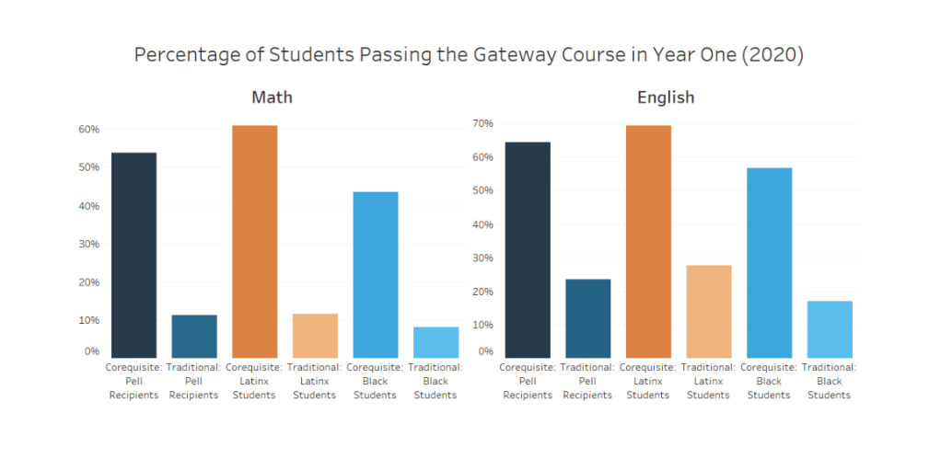
Illinois: Co-req is better!
Notes:
This is from the first progress report. First, notice that the chart doesn’t go to 100% . More than half of the Black students still fail. They are *not* separated by skill level. Could it be that the significant numbers of students who failed were the ones least prepared? Because of racism and inequities? Might they have benefited from a course to prepare them?
Yes, there is research that says developmental ed courses are only “harmful” to the students who are almost prepared enough; they benefit the others. Still, PCC wants them gone.
https://partnershipfcc.org/publications/a-progress-report-on-reforming-developmental-education-in-illinois/ Saucedo, J., & Roe, L. (2o24, July 29). Developmental Education Reform in Illinois. Democracy's College, Episode 57. (S. Bennett, Interviewer) Retrieved from https://occrl.illinois.edu/docs/librariesprovider2/podcast/episode-57-developmental-education-reform-in-illinois.pdf
Boatman, A., & Long, B. T. (2018). Does Remediation Work for All Students? How the Effects of Postsecondary Remedial and Developmental Courses Vary by Level of Academic Preparation. Educational Evaluation and Policy Analysis, 40(1), 29–58. https://doi.org/10.3102/0162373717715708

Slide 14
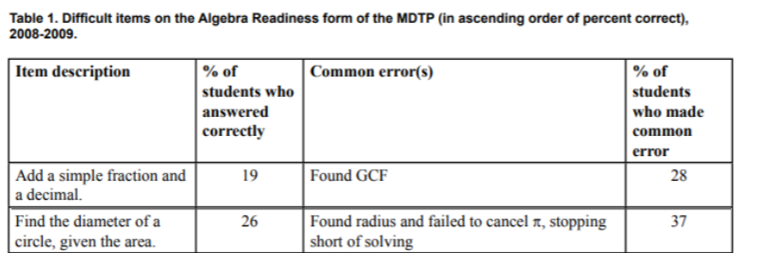
Maybe they just need review?
What Community College Developmental Mathematics Students Understand about Mathematics
James W. Stigler, Karen B. Givvin, and Belinda J. Thompson University of California, Los Angeles
Notes:
What? They don’t just need a little review?
These folks at the Carnegie Institute analyzed test results and did extensive interviews. Based on the questions and the student testimony: Math was memorizing procedures that you didn’t remember well.
Students can successfully answer questions that are presented *as they would expect them to be presented.* Adding a fraction and a decimal, though? That requires basic understanding. Four out of five students placing in developmental math missed that question.
There are many, many other resources that show that no, we really *do* have a lot of students who want to go to college, but don’t have the math knowledge to succeed in college level math.
What Community College Developmental Mathematics Students Understand about Mathematics James W. Stigler, Karen B. Givvin, and Belinda J. Thompson University of California, Los Angeles
Stilgler, J. W., Givvin, K. B., & Thompson, B. J. (2010, May). “What Community College Developmental Mathematics Students Understand About Mathematics.” MathAMATYC Educator. Retrieved from https://www.carnegiefoundation.org/wp-content/uploads/2013/05/stigler_dev-math.pdf
Students can successfully answer questions that are presented *as they would expect them to be presented.* Adding a fraction and a decimal, though? That requires basic understanding.
There are many, many other resources that show that no, we really *do* have a lot of students who want to go to college, but don’t have the math knowledge to succeed in college level math.

Slide 15
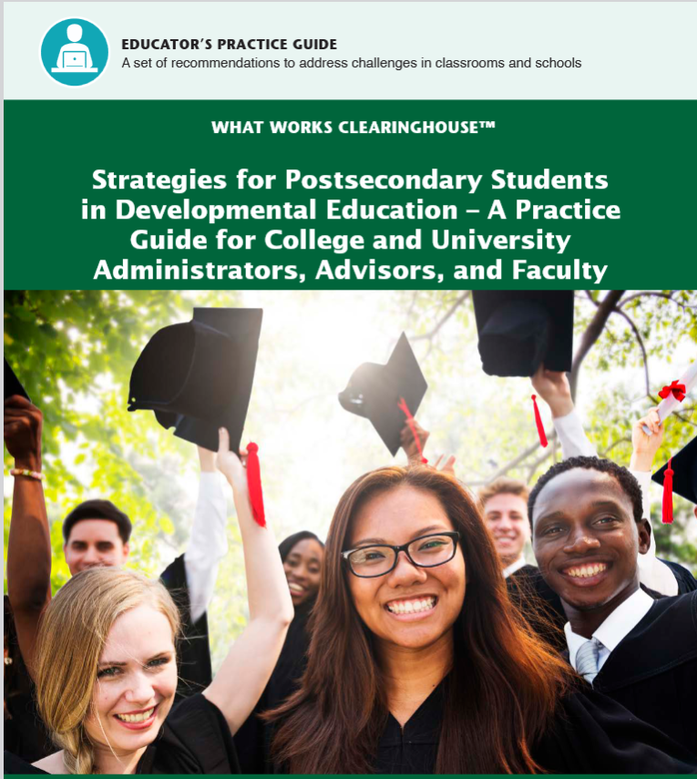
Why the focus on co-requisites? There are other options.
Notes:
Another question: This is a meta-analysis of research on developmental education from the Institute of Educational Sciences. They noted 6 different recommendations and described the best ways to implement them. They also noted which of the recommendations had the best evidence to support implementing these measures.
The goal of this practice guide is to pres-
ent rigorously and systematically reviewed
evidence in support of practical recommenda-
tions for improving outcomes for students
at-risk for, or placed into, developmental
education. The practice guide primarily
focuses on interventions or practices aimed
at improving students’ progress through
developmental education, credit accumula-
tion and persistence, academic achievement,
and degree attainment.
Bailey, T.R., Bashford, J., Boatman, A., Squires, J. and Weiss, M (2016). “Strategies for Postsecondary Students in Developmental Education – A Practice Guide for College and University Administrators, Advisors, and Faculty” Institute of Educational Sciences, https://ies.ed.gov/ncee/WWC/Docs/PracticeGuide/wwc_dev_ed_112916.pdf

Slide 16
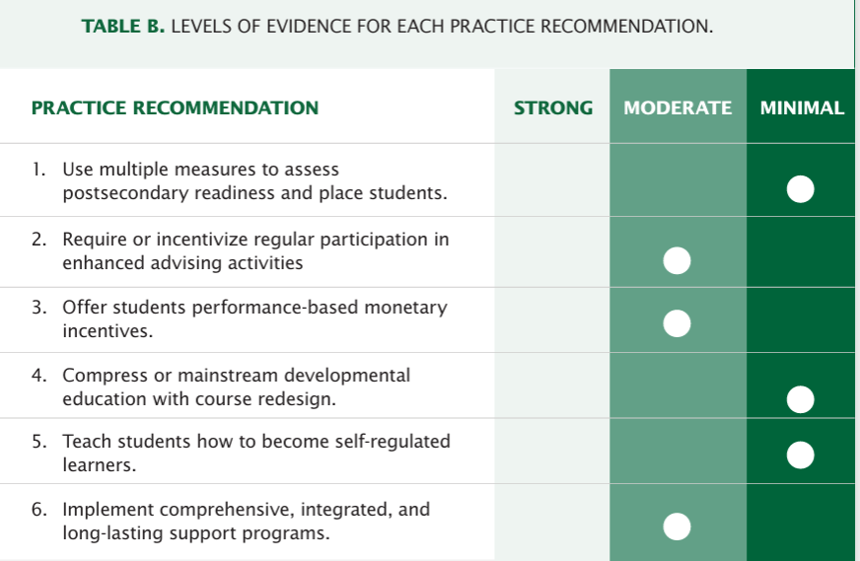
Co-requisites mean to "compress or mainstream developmental education with course design."
Compressing or mainstreaming – co-requisite courses – didn’t even yield minimal support for math.
Notes:
It seems our reformers chose the practices that had minimal evidence. In math, compression and acceleration were found to have NO evidence for recommendation. I don't think it's a coincidence that the measures with better evidence are the ones that require more direct investment in students and instructors staff instead of consultants for course redesign and removing options.
Bailey, T.R., Bashford, J., Boatman, A., Squires, J. and Weiss, M (2016). “Strategies for Postsecondary Students in Developmental Education – A Practice Guide for College and University Administrators, Advisors, and Faculty” Institute of Educational Sciences, https://ies.ed.gov/ncee/WWC/Docs/PracticeGuide/wwc_dev_ed_112916.pdf

Slide 17
No need to just repeat what they should have learned in high school.
We can respect their adult minds and teach the concepts and skills in relevant contexts.
We can focus on the concepts they'll need so that they can then have more pathways to choose from.

Slide 18
You need “foundations” of arithmetic, ratios, proportions, expressions and simple equations for:
Mean, mode and median – what are the formulas?
More importantly, what is "centering" ?
Percent problems - it's worth *taking the time to build proportional reasoning.*
  Find the discount, find the new price, find the original price, find the percent increase or decrease
  When the concepts are understood, it all makes sense.
Linear relationships:
Notes:
I’ve worked w/ students who had our pre-Algebra course before taking Statistics or the next Algebra courses. It makes a world of difference.
Our students who get into the “co-req” courses without good scores simply don’t do as well. Consistenlty. We have the data.
We can build these concepts – but it takes tme. Trying to do it *while also taking a college level math course* is a huge cognitive burden. Students can end up taking Calculus 3 times because they were trying to figure out the algebra as they went.
Adults who've never wrestled with working with two variables memorize formulas for linear equations and slope and try to survive the test. When they have time to build the understanding, complex algebra and exponents are steps forward, not impossible mysteries. Systems of equations aren't the stuff of bad dreams. One of mine confessed she *likes* solving the systems of equations with different strenthgs of solutions.
https://ncee.org/what-does-it-really-mean-to-be-college-and-work-ready/ National Center on Education and the Economy, What Does It Really Mean to Be College and Work Ready? The Mathematics and English Literacy Required of First Year Community College Students (Washington, D.C.: National Center on Education and the Economy, May 2013).
TOPICS:
Make it two slides with more images

Slide 19
Oh,yes, foundations:
Geometry (perimeter, area, volume)
Unit conversions
Notes:
Again, building solid proportional reasoning means teachers don't have to say, "how did they get this far and not be able to do this??" SO many of the "Pathways" they talk about need these concepts but we're supposedto wedge them in between the college level content.

Slide 20
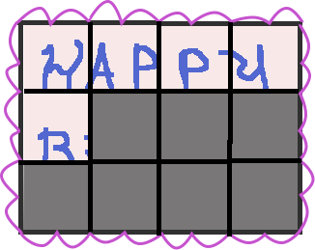
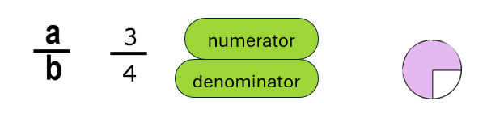
Don’t throw it out, figure it out!
Teachers who are successful teaching developmental math have figured out that “lecture, they take notes, they learn it, they pass tests” doesn’t work well. (See Cafarella’s dissertation on what works.)
Different teachers do different things: I make LOTS of pictures and teach them why and how to think about things.
Cafarella, B. (2013, May). Exploring Best Practices in Developmental Mathematics. Dayton, Ohio. Dissertation.
Retrieved from https://etd.ohiolink.edu/acprod/odb_etd/ws/send_file/send?accession=dayton1365611799&disposition=inline

Slide 21
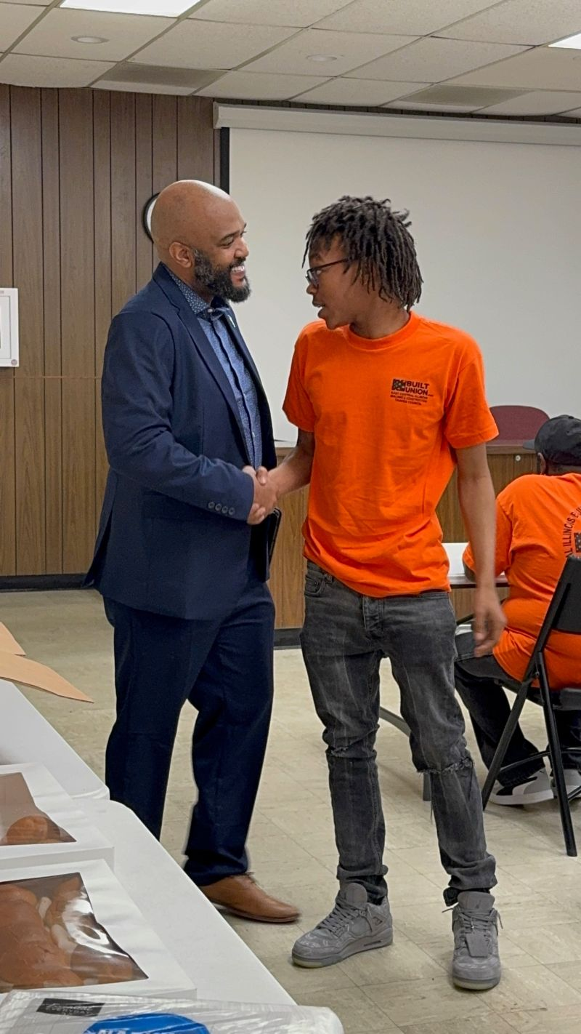
Make it meaningful, with room for acceleration.
There is no need to re-teach from high school courses. We can respect their adult minds and teach the foundations in contexts that make sense, and *teach the thought processes* needed for arithmetic, multiplicative thinking and proportional reasoning – as well as algebra.
We can teach the process of keeping track of different kinds of units, in the context understanding equality, with arithmetic, ratios and proportions. *These* are the skills most needed whether for college math or career preparation.
We can get people onto a pathway – that can go in whatever direction they want!
That’s Jaden, who came for tutoring from our “Apprenticeship Preparation” program, at their graduation with our mayor. He learned the math and he’s still learning
Notes:
https://ncee.org/what-does-it-really-mean-to-be-college-and-work-ready/ National Center on Education and the Economy, What Does It Really Mean to Be College and Work Ready? The Mathematics and English Literacy Required of First Year Community College Students (Washington, D.C.: National Center on Education and the Economy, May 2013).
TOPICS:

Slide 22
Yes, we need to address math education inequities.
Developmental education courses aren’t the source of the inequities.
Designing policies as if they are – as is happening -- *prevents us* from addressing the real sources.
Let’s recognize that many students have complex needs, so *going faster* may be the worst strategy.
Let’s Open doors and opportunities, not close them!

Slide 23
Thank you!
Sue Jones
sujones@parkland.edu

