Slide 1

Exponential Growth

Slide 2
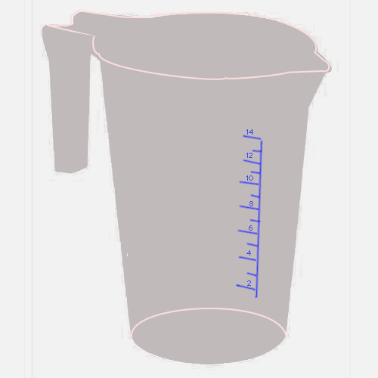
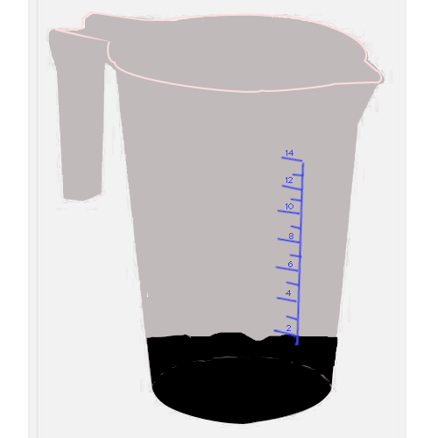
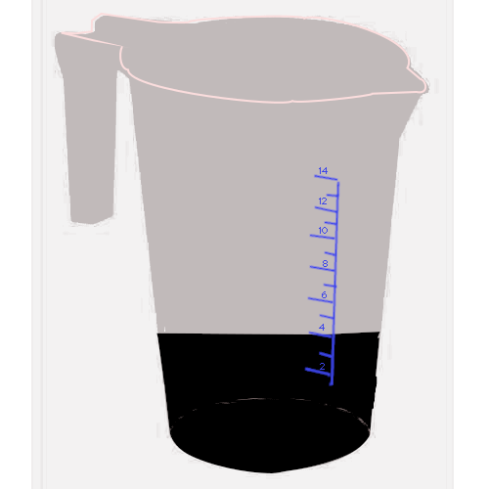
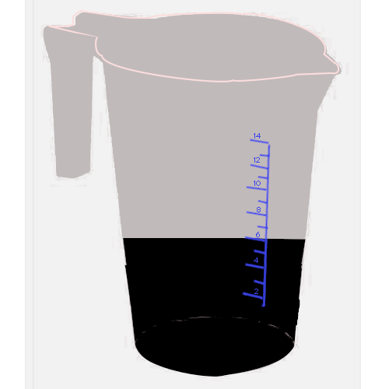
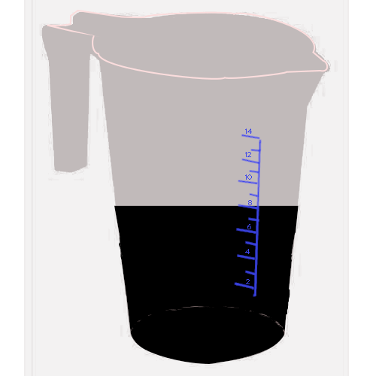
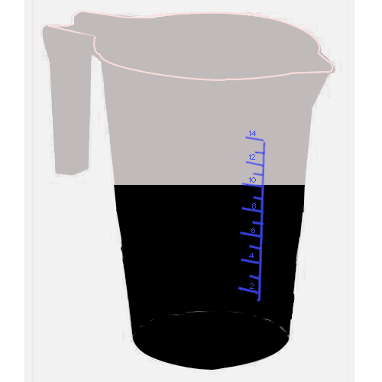
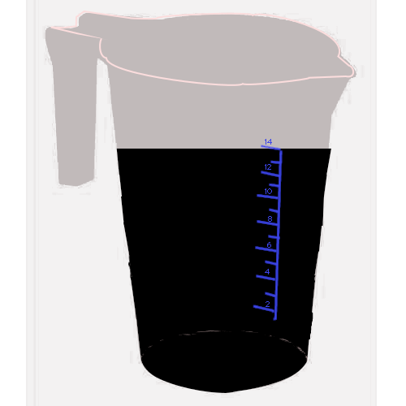
Let’s talk about change!
Sometimes it’s predictable!
Notes:
Let’s talk about change! Sometimes change just happens, but often, it’s predictable.
If I save my coffee grounds for the compost pile, and I add 2 ounces of coffee grounds to it every day, this will happen:

Slide 3
A table:
Days | Coffee Grounds
1 | 2
2 | 4
3 | 6
4 | 8
5 | 10
6 | 12
7 | 14
Notes:
If we made a table of the days and coffee grounds amounts, it would look like this:

Slide 4
A graph – it’s linear
Notes:
If we made a graph it would look like this It’s “linear” growth – it makes a straight line.

Slide 5
Calculating
How much coffee grounds in how many days?
Y = 2x
Notes:
I can make an equation to describe this change pattern: Y, the coffee grounds = 2 times x, the number of days I’ve been adding them. We’re adding the same amount again and again and again – otherwise known as multiplication.

Slide 6

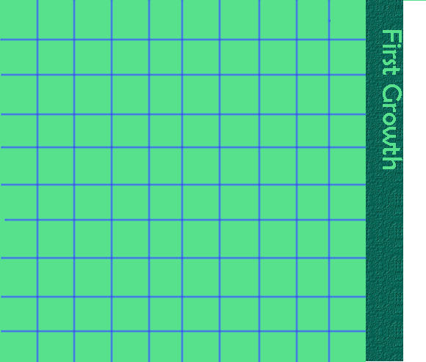
What if *everything* keeps growing?
Original Moss
Original Moss + 10%
100%
100%
10%
Notes:
But what if we had something that was growing – and all the parts kept growing? So, this 100 cm² clump of moss in the garden grows 10 percent… of the whole thing in, oh, a month.

Slide 7

It gets… complicated.
Original Moss 100 + ten percent
Original Moss
100%
That “Original moss and ten percent” -- PLUS ten percent of the original moss PLUS 10 percent of the ten percent of the last one.
Notes:
The first month we can figure out 10% and add that to the original. 10% of 100 is 10…. 100 + 10 is 110.
But the next month? We have the original moss and ten percent, plus ten percent of the original moss… PLUS 10 percento of the ten percent that grew with the last month. What???

Slide 8
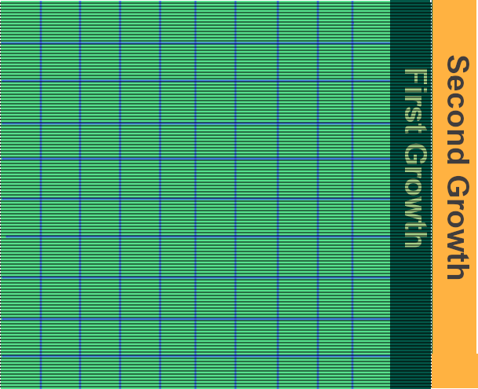
We can do better ☺ 100% + 10% = 1 + .10 = 1.1. Growth factor.
1.1 x 100 (original amount) = 110 cm²
100%
10%
100%
100 x 1.1 x 1.1
Original Moss
Our new whole
100%
10%
Notes:
There’s a short cut. With linear growth, we’re adding the same amount each change.
With exponential change, we are *multiplying* by the same amount.
We can add the *percents* first – changing to decimals. and then multiply that by our original amount of moss.
100% + 10% = 1 + .10 Or 1.1. That’s our “growth factor.”
Next month? That whole amount is going to grow so we just take the answer … the 110 cm² and multiply that by 1.1 again.
100 x 1.1 x 1.1

Slide 9
Yes, we can do that with other “percentage” growth: 8% tax on a 50$ - what’s the new total?
OR!!!
8 % of 50 = .08 x 50 = 4 $$$
50 + 4 = 54 54 dollars.
100% + 8% = 108% 1.08 x 50 = …. Surprise!!! $54.

Slide 10
So each month we multiply what we had from the last month by 1.1. It’s the growth rate.
Original Moss x 1.1 (110%)
Original Moss
100%
Last month’s --Original Moss x 1.1 -- x 1.1 again

Slide 11
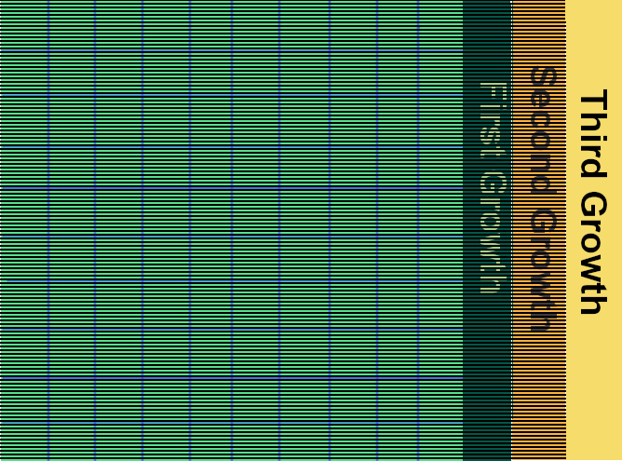
Next change? Just multiply again!
Original moss x 1.1 x 1.1.
Original Moss
Original moss x 1.1 x 1.1
x 1.1
Original Moss
x 1.1
Notes:
The next month? Applying our shortcut, we’d multiply the answer to the second amount by 1.1 for the third… and – we have a shorter way of writing this: Exponents!

Slide 12
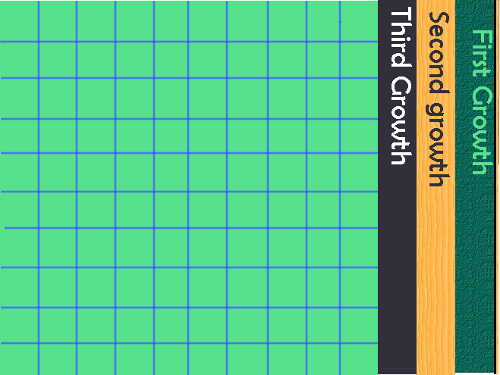
Exponents! Moss Amount = 100(1.1)^{x}
Original moss x 1.1 x 1.1
x 1.1
Original Moss
100 is the starting point, 1.1 is the growth factor (1 + growth as a decimal) and x is the number of increases.

Slide 13
Table and graph:
Ten Percent Growth,
Months | Start at 100 | How much bigger? (Subtract old from new)
0 | 100
1 | 110 | 10
2 | 121 | 11
3 | 133 | 12
4 | 146 | 13
5 | 161 | 15
6 | 177 | 16
7 | 195 | 18
8 | 214 | 19
9 | 236 | 21
10 | 259 | 24
11 | 285 | 26
12 | 314 | 29
Notes:
Here’s our time and amount of moss on a table and a graph – as well as how much it grew. I included how much it changed: it’s *not* the same. You can see that we are gaining more with every month.
We *are* multiplying by the same factor – 1.1 – each time.

Slide 14
Growths | Exponential | Linear
0 | 100 | 100
1 | 110 | 110
2 | 121 | 120
3 | 133 | 130
4 | 146 | 140
5 | 161 | 150
6 | 177 | 160
7 | 195 | 170
8 | 214 | 180
9 | 236 | 190
10 | 259 | 200
11 | 285 | 210
12 | 314 | 220
Notes:
Here’s how exponential growth looks on a graph comparing it to linear change starting with the same change of 10 units. They are close for a while, but you can watch the exponential change get bigger with every change.

Slide 15
The equation part ☺ 10% growth, exponentially speaking.
Y=100(1+.10)^{x}
OR
y = 100(1.1)^{x}
X Months | Y How many cm² moss? 10% growth | "long way" calculation
0 | 100 | Starting point!
1 | 110 | 100 x 1.1
2 | 121 | 100 x 1.1 x 1.1
3 | 133 | 100 x 1.1 x 1.1 x 1.1
4 | 146 | 100 x 1.1⁴
5 | 161 | 100 x 1.1⁵
6 | 177 | 100 x 1.1⁶
Anything times something BIGGER THAN ONE …. Gets bigger.
Notes:
To wrap this up: Each month, we’re multiplying by our growth factor another time – we use exponents to write that.
So to figure out Y – how many square centimeters of moss I have – I take my starting point and multiply it by the growth *factor.* raised to the “x” power – the number of months.
10% is the growth *rate* -- that’s how much bigger than 100% we’re getting – but we need to add that to 1 to get our growth *factor* -- what to multiply by.
Here’s a pattern for multiplication: Anything times 1 is itself, right?
Anything times anything bigger than one gets bigger!!! Not always a LOT bigger, but bigger.
And we’ll stop right here – the next video will ask about what happens when we’re shrinking!

Slide 16
Yes, you can use all or part of this ☺
Please attribute to Susan Jones with a link to http://www.resourceroom.net
Except where otherwise noted, this work is licensed under https://creativecommons.org/licenses/by/4.0/
This license lets others modify work even for commercial purposes, as long as credit is given to me. See https://creativecommons.org/licenses/ for more information & links to the license deed and legal code.
My email is sujones@parkland.edu
Notes:
http://www.achieve.org/EQuIP
http://creativecommons.org/tag/k12-oer-collaborative

Slide 17
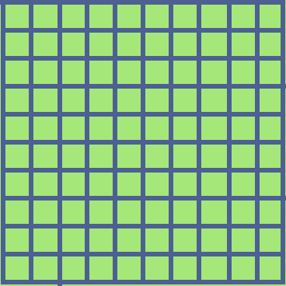
What if we’re shrinking?
If it’s linear, we subtract the same amount. So if we’re whacking off 10 cm² each hour, from our original 100 cm²

Slide 18
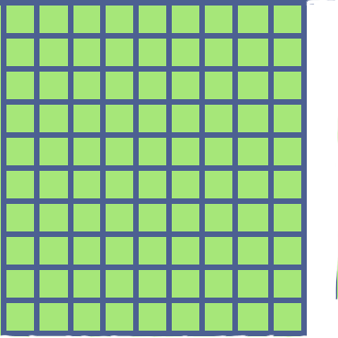
First time
90 cm²

Slide 19
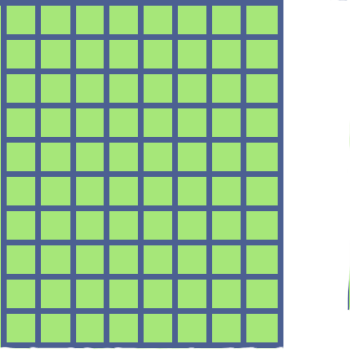
80 cm²

Slide 20
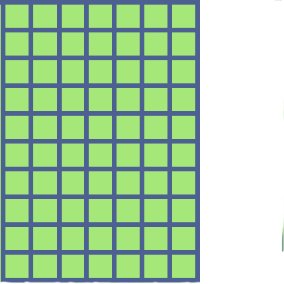
70 cm²

Slide 21
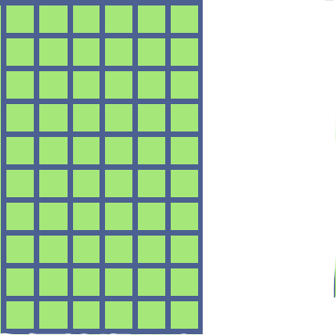
60 cm²

Slide 22
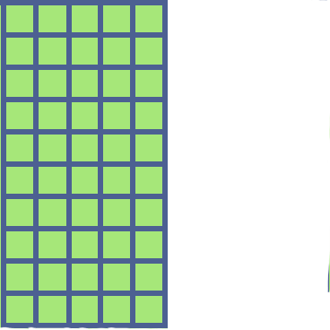
Still shrinking…
50 cm²

Slide 23
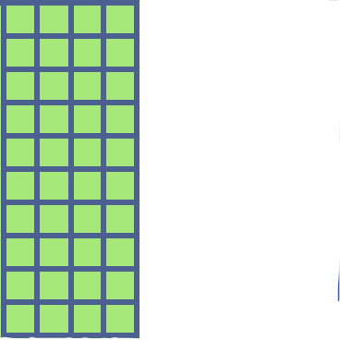
40 cm²

Slide 24
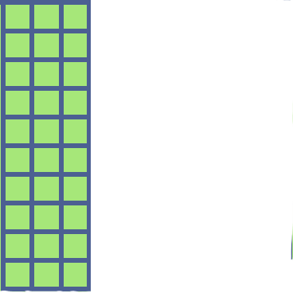
30 cm²

Slide 25
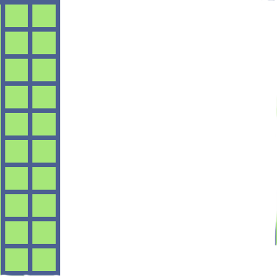
20 cm²

Slide 26
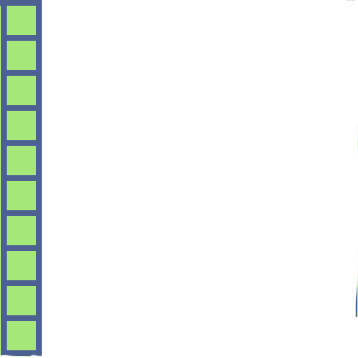
10 cm²

Slide 27
And it’s GONE!!!
Y = 100 – 10x.
In 10 hours of pruning, you’ve gotten rid of all that moss. If it’s ***really*** ***all*** ***gone*** you’re done with it!!!

Slide 28
But now… exponential decay…. We lose a fraction part each time.
I’m going to take away 10% of 100 – that would be 10. We’ve got 90 left, just like linear.

Slide 29
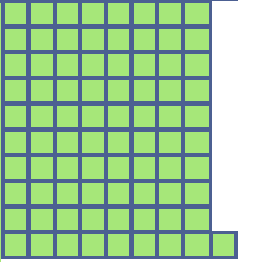
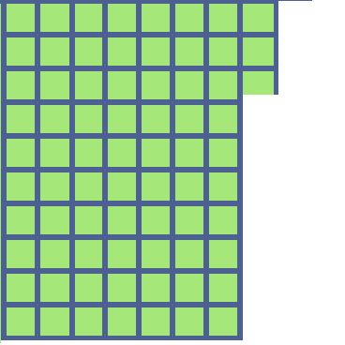
Next time it’s different…
I’m going to take away 10% of 90 – that would be 9. So I’ll have 81 left.
And the next time? 10% of 81 is 8.1 to take off so I’ll have 72.9 left…
90%
90%
100%
10%

Slide 30
Let’s use that short cut, subtracting the percents-turned-decimal instead of adding.
What’s our shrink factor? 1 - .10 = 0.9 (100% - 10% = 90%)
90%
90%
100%
10%
10%
100 cm²
100 cm² x 0.9
100 cm² x 0.9 x 0.9

Slide 31
So, we can write that as an exponent: Moss Amount = 100(1-.1) ^{x} or Moss Amount = 100(0.9) ^{x}
What’s our shrink factor? 1 - .10 = 0.9 (100% - 10% = 90%)
90%
90%
100%
10%
10%
100 cm²
100 cm² x 0.9
100 cm² x 0.9 x 0.9

Slide 32

Why are we multiplying? How can multiplying make something shrink?
We undo multiplying with division – or “Multiplying by a fraction between 0 and 1.”
“half of ten” is ½ times ten, or 0.5 times ten.
Notes:
You may be asking: with linear, we subtracted to make things get smaller. We undo adding with subtracting – or “adding a negative.”

Slide 33
Numbers close to 1 shrink a little bit or grow a little bit.
600 x 0.95 = 570 – a little bit smaller
600 x 1.05 = 630 … a little bit bigger.

Slide 34
What did we learn?
Exponential Growth
Exponential Decay
Growth by N% -- add percents (changed to decimals) to get growth factor.
Use exponents!
Example: 7.6 % growth, starts at 340, grows 4 times
1 + .076 = 1.076
New amount = 340(1.076)⁴
decay (shrink) by N% -- subtract percents (changed to decimals) to get shrink factor.
Use exponents!
Example: 4% decay, starts at 500, shrinks 6 times
New amount: 500(0.96) ⁶

Slide 35
We can add percent to percent. We start with 100% -- the whole thing, we’re keeping that!
100%
100%
10%
Original Moss
Original Moss + 10%
100 + 10 = 110%. Change that to a decimal, and multiply it by our moss amount, 100. 100 x 1.1 = 110.

