Slide 1
CASAS test question

Slide 2
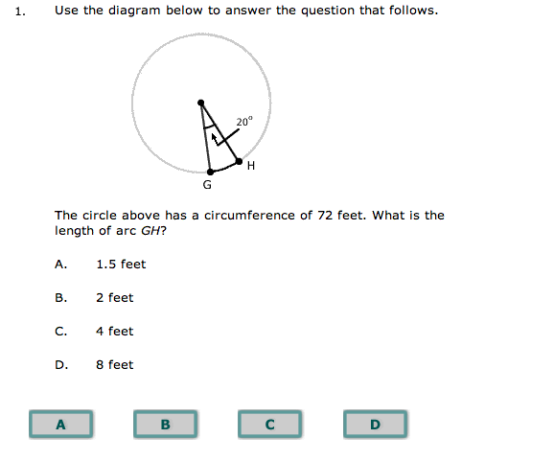
Notes:
This is a question in a “sample test” of the CASAS test.
Your job is to figure out what it’s asking and then figure out how to answer it.

Slide 3
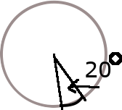
What is this question asking?
The “arc” is the curved part of the circumference of the circle. Remind yourself what the circumference is 😊 or go to the next slide.

Slide 4

Circumference: all the way around.
If you took a walk around the circle, the circumference would be how far you had to walk. The problem tells us the *whole* way around is 72 feet.
Notes:
If I hve time, do my little animated dots thing around the circle.

Slide 5
Circumference: all the way around
If you took a walk around the circle, the circumference would be how far you had to walk. The problem tells us the *whole* way around is 72 feet.
Notes:
If I hve time, do my little animated dots thing around the circle.

Slide 6
What’s the arc again?
Notes:
The “arc” is the curved part of the circumference of the circle – that little red part. I want to know how long that part of the circle is.
We know the *whole* thing is 72 feet, but we don’t know how long the rest of the circle is, or we could subtract.

Slide 7
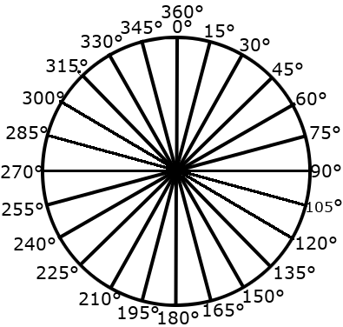
What can we do with that 20 degrees?
Notes:
We DO know how widely those 2 lines opened – the angle – to get that distance. We opened that corner 20 degrees.
And we SHOULD know one more thing: The amount of degrees in the WHOLE circle. It’s always 360.

Slide 8
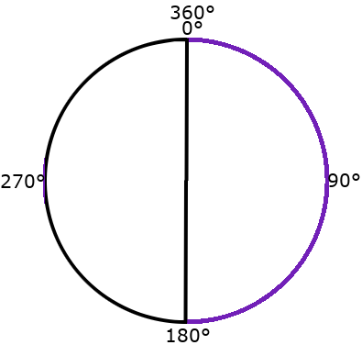

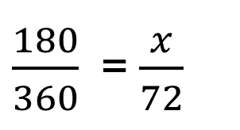
Proportion time
$\frac{part}{whole}$ = $\frac{part}{whole}$
$\frac{180}{360}$ = $\frac{x}{72}$
Notes:
When two relationships are proportional then they have the same relationship. If we had an “arc” that was half way around, that would be 180 degrees. If the circumference were 72, then halfway around it would be 36. The equation to solve it would look like this: $\frac{180}{360}$ = $\frac{x}{72}$
We could solve that by cross multiplying

Slide 9

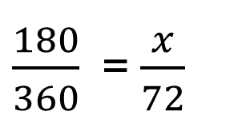
Proportion time
$\frac{part}{whole}$ = $\frac{part}{whole}$
360x =180 (72) 360x = 12,960
X= 36
$\frac{180}{360}$ = $\frac{x}{72}$
Notes:
When two relationships are proportional then they have the same relationship. If we had an “arc” that was half way around, that would be 180 degrees. If the circumference were 72, then halfway around it would be 36. The equation to solve it would look like this: $\frac{180}{360}$ = $\frac{x}{72}$
We could solve that by cross multiplying

Slide 10

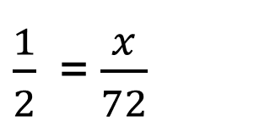
Proportion time
$\frac{part}{whole}$ = $\frac{part}{whole}$
$\frac{180}{360}$ = $\frac{x}{72}$
$\frac{1}{2}$ = $\frac{x}{72}$
Notes:
Or, reduce the fraction: …. Half of 72 is 36. You’ll be allowed to use a calculator.

Slide 11
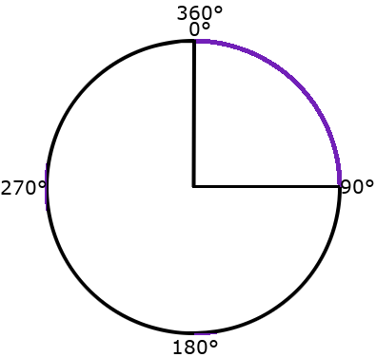

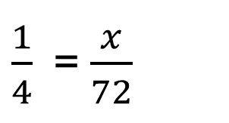
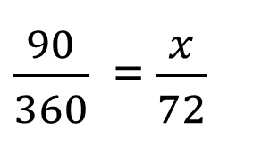
Proportion time
$\frac{part}{whole}$ = $\frac{part}{whole}$
$x=18$
$\frac{90}{360}$ = $\frac{x}{72}$
$\frac{1}{4}$ = $\frac{x}{72}$
Notes:
If we shrink it to 90 degrees, we’d find x = 18 --

Slide 12

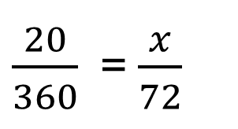
Proportion time
$\frac{part}{whole}$ = $\frac{part}{whole}$
$360x=72 \left(20\right)$
360$x=1440$
$x=4$
$\frac{20}{360}$ = $\frac{x}{72}$
Notes:
at 20 degrees… x is four.

Slide 13
Summary:
Figure out what you know that’s in the problem (whole circumference is 72, arc angle is 20 degrees)
Figure out what *else* you know that will help (a whole circle is 360 degrees)
Figure out what math will help you answer the question.
Notes:
Figure out what

