Slide 1
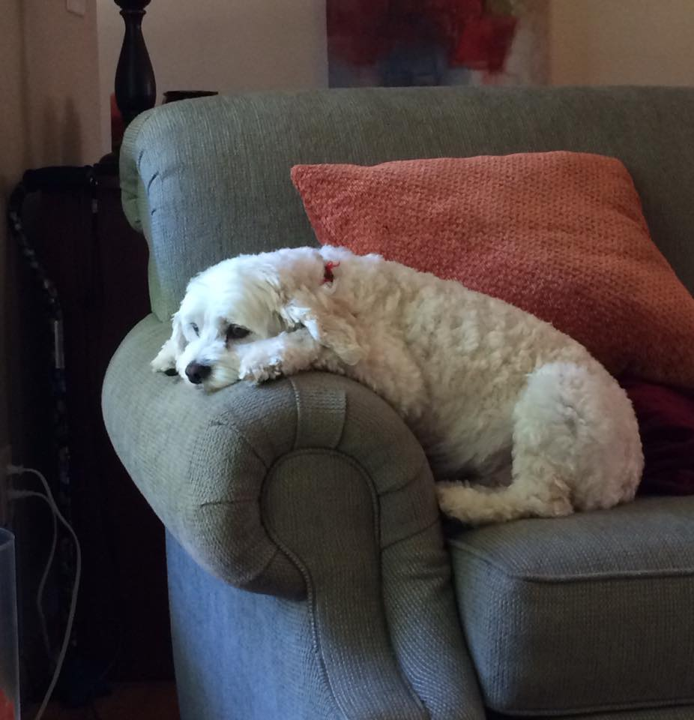
Memorizing the Twos -- Part two ☺

Slide 2
2 x 1 =
2 x 2 = 4
2 x 3 =
2 x 4 = 8
2 x 5 =
2 x 6 = 12
2 x 7 =
2 x 8 = 16
2 x 9 =
2 x 10 = 20
Notes:
So... These are the twos times tables... In Part 1 we practiced the odd ones.

Slide 3
2 x 9 = 18
2 x 5 = 10
4
8
2 x 7 = 14
12
16
20
2 x 1 = 2
2 x 3 = 6
2 x 10 = 20
Notes:
Let’s get rolling. Okay, 2 x 6 = 12 == you’re out of here.
2 4 __ 8 ___ ___ ___ 16 __ 20.

Slide 4
4
8
16
20
2 x 6 = 12
2 x 10 = 20
Notes:
Now, if you odn’t remember the big ones, you can start with 2 x 5 is 10 and then jump forward two and get to 2 x 6 is 12.
...

Slide 5
2 x 9 = 18
2 x 5 = 10
4
8
2 x 7 = 14
16
20
2 x 1 = 2
2 x 3 = 6
2 x 10 = 20
Notes:
Time for the big guy to fly. 2 x 10 is 20. Bye Bye! (Count ‘em off again.)

Slide 6
4
8
16
20
2 x 6 = 12
2 x 10 = 20
Notes:
...

Slide 7
2 x 9 = 18
2 x 5 = 10
4
8
2 x 7 = 14
16
2 x 1 = 2
2 x 3 = 6
2 x 6 = 12
2 x 8 = 16
2 x 10 = 20
2 x 4 = 8
Notes:
Let’s clear thebottom row! 2 x 8 is 16. Doodly doo, 8 x 2....
(count ‘em off...) !

Slide 8
2 x 9 = 18
2 x 5 = 10
4
8
2 x 7 = 14
2 x 1 = 2
2 x 3 = 6
2 x 10 = 20
Notes:
2 x 4 is 8.... That’s great!

Slide 9
4
8
2 x 6 = 12
2 x 8 = 16
2 x 10 = 20
Notes:
...

Slide 10
2 x 4 = 8
4
2 x 6 = 12
2 x 8 = 16
2 x 10 = 20
Notes:
...

Slide 11
2 x 9 = 18
2 x 5 = 10
4
2 x 7 = 14
2 x 1 = 2
2 x 3 = 6
2 x 10 = 20
Notes:
And ... Finally... 2 x 2 is 4.... There are no more!!! One last countoff...

Slide 12
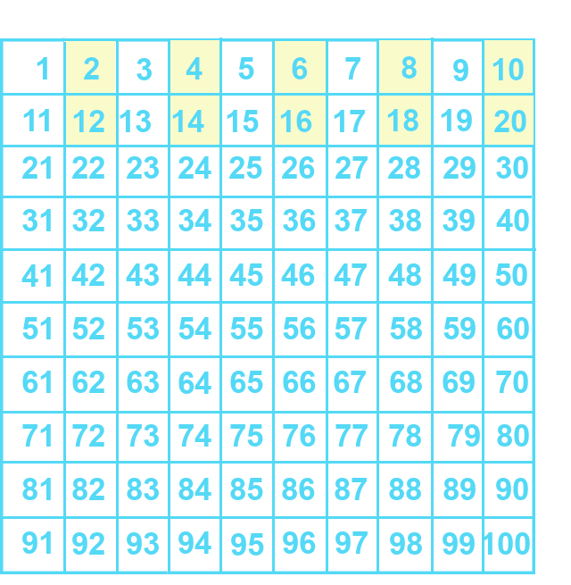
Notes:
Keep on practicing ☺ Next video – doubling bigger numbers.

Slide 13
2
4
6
2 x 1=
2 x 2 =
2 x 3 =
8
10
12
2 x 4 =
2 x 5 =
2 x 6 =
14
16
18
2 x 7 =
2 x 8 =
2 x 9 =
Notes:
The big guy – 6 x 9 - 54
Double Dude – 6 x 2 = 12

Slide 14
Yes, you can download, share, &/or change this if you:
Please attribute to Susan Jones with a link to http://www.resourceroom.net
This work is licensed under https://creativecommons.org/licenses/by/4.0/
This license lets others modify work even for commercial purposes, as long as credit is given to me. See https://creativecommons.org/licenses/ for more information & links to the license deed and legal code.
My email is sue@resourceroom.net
or sujones@parkland.edu

