Slide 1
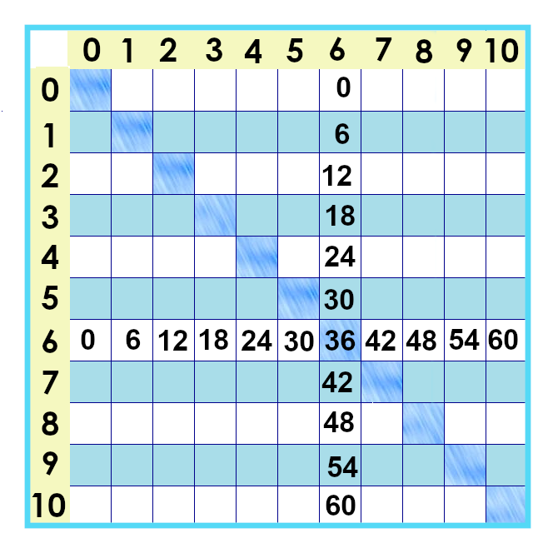
Notes:
We are really really *almost* there. Let’s look at the six times tables! Six times six is 36.

Slide 2
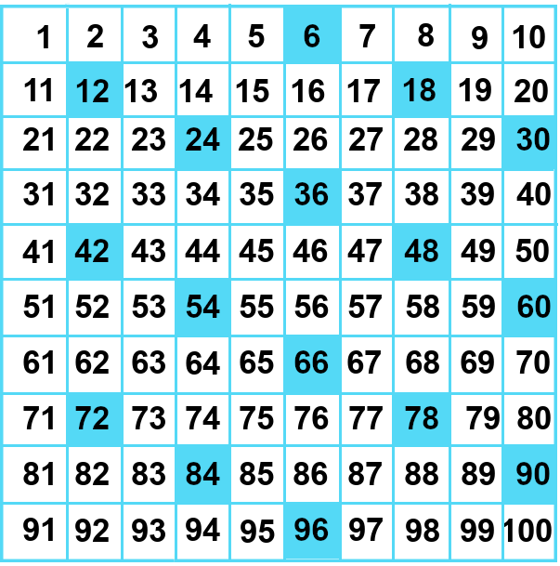
Notes:
Here’s what they look like on the number chart. Hmmm. Notice anything? It’s a little bit like the nines and threes but sort of backwards.

Slide 3
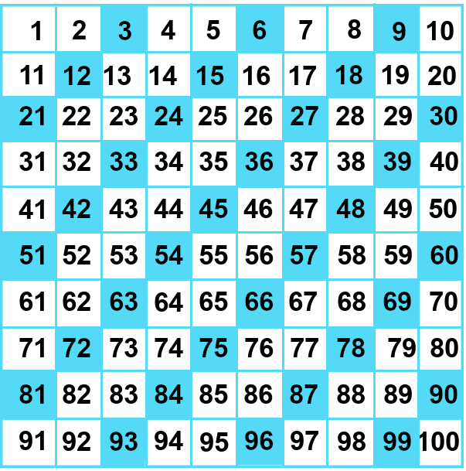
Notes:
Let’s Compare this to the threes times tables.
Yea, all the multiples of sixes are multiples of threes. How does this one work?

Slide 4
3 x 2= 6
Notes:
Every group of six has 2 groups of 3 in it. We can’t arrange them as a square, but we can remember that any multiple of 6 is a multiple of 3 *and* a multiple of 2.

Slide 5
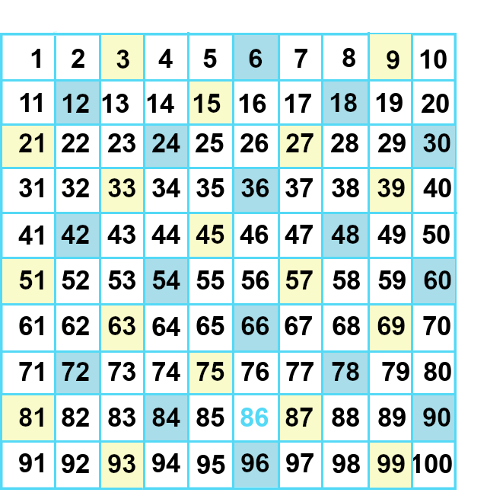
Notes:
So… the multiples of six are the even numbers that you can divide by 3.

Slide 6
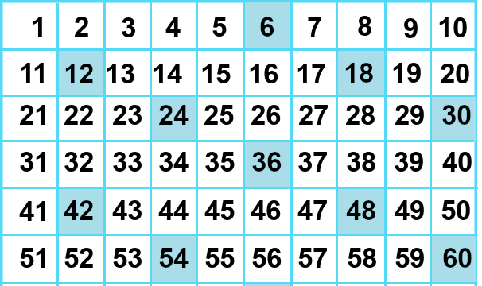
Notes:
Okay, here they are – but let’s zoom in on the 3 we didn’t already cover.
6 x 6 ---- which we could also call six squared, right? It’s 36.
6 x 7 = 42.... Dinner for six at 7 on 42nd street....
6 x 8 is 48.....
If you remember that 6 x 4 is 24 ... It’s great to be completely sure, 6 x 4 is 24....
Then... Double that for 48. Multiplying by 8 is doubling **3** times.

Slide 7
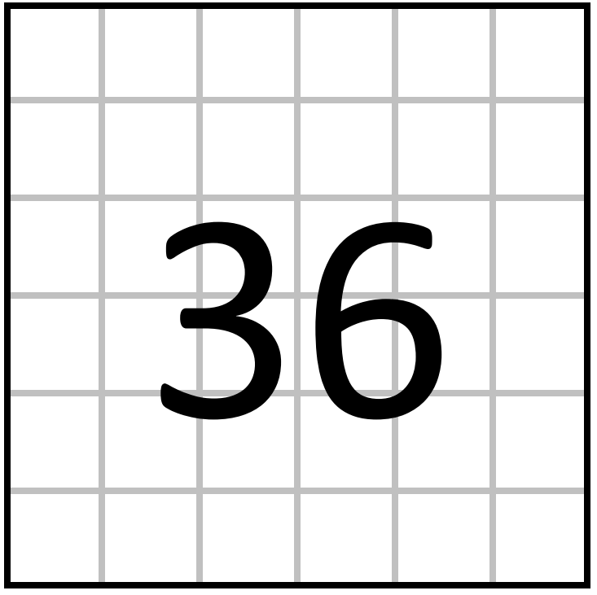
6 x 6= 36
Notes:
First, our perfect square: 6 x 6 is 36.

Slide 8
6 x 6= 36
6 x 6=
Notes:
First, our perfect square: 6 x 6 is 36.

Slide 9
6 x 7 = 42
Notes:
Six times 7 is 42….

Slide 10
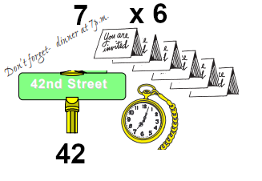
6 x 7 = 42
Notes:
Six times 7 is 42…. Maybe a story will help with this one – Dinner for six, at seven oclock… on 42nd street….

Slide 11
6 x 8 = 48
Notes:
Rhyhming tables are great! Six times 8 is 48~

Slide 12
Notes:
Going back over things – the six tables are *all even numbers* -- but they are also multiples of three.

Slide 13
6 x 6 = 36
6 x 8 = 48
6 x 7 = 42
6 x 6 = 36
6 x 8 = 48
6 x 7 = 42
Notes:
Six times six is 36
Six times 8 is Forty Eight
Six times 7 is 42.

Slide 14
6 x 0 = 0
6 x 1= 6
6 x 2 = 6
6 x 3 = 9
6 x 4 = 12
6 x 5 = 15
6 x 6 = 36
6 x 7= 42
6 x 8 = 48
6 x 9 = 54
6 x 10 = 60
Notes:
Here they are! Time for practice ☺

Slide 15
Yes, you can download, share, &/or change this if you:
Please attribute to Susan Jones with a link to http://www.resourceroom.net
This work is licensed under https://creativecommons.org/licenses/by/4.0/
This license lets others modify work even for commercial purposes, as long as credit is given to me. See https://creativecommons.org/licenses/ for more information & links to the license deed and legal code.
My email is sue@resourceroom.net
or sujones@parkland.edu
Notes:
Thelegal stuff...

