Slide 1
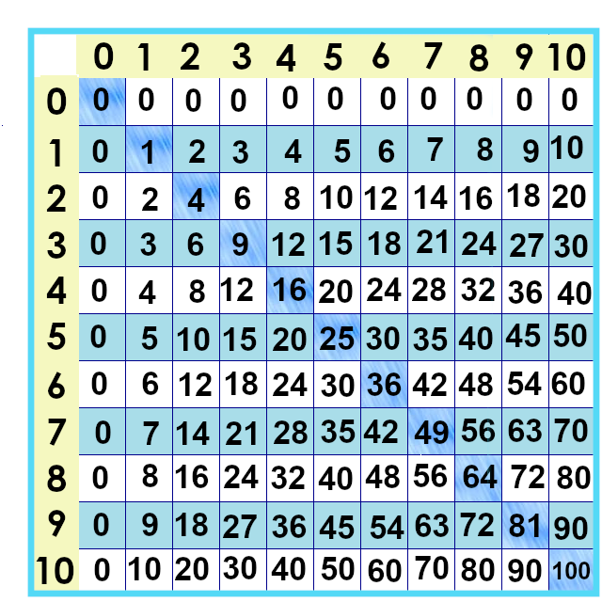
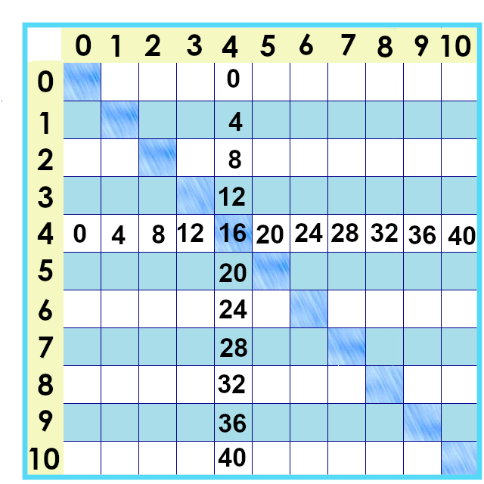
Notes:
This is what the fours look like on the times tables chart.

Slide 2
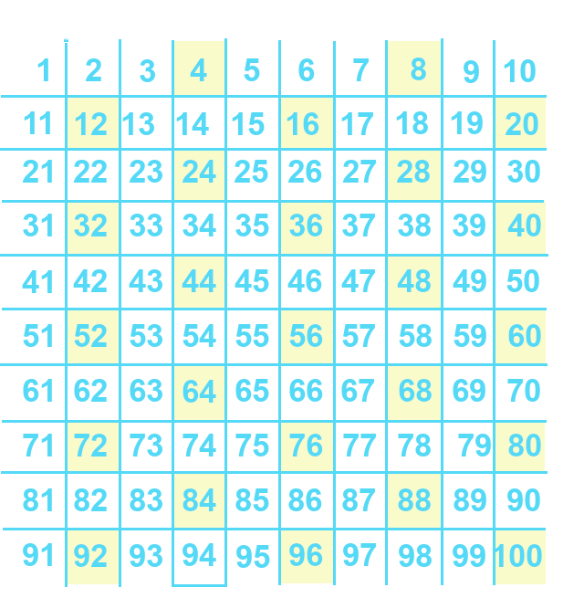
Notes:
And this is what they look like on the number chart. To multiply a number by four, we can double that number twice.

Slide 3
3 x 2=6
6 x 2=12
Notes:
For four times three... We double three to get six, and double six to get twelve.
Why does this work?

Slide 4
3 x 4
3 x 2 x 2
6
x 2
12
Notes:
Why does this work? Let’s look at … 3 x 4…. And try to do it with just numbers. Leave the socks in the drawer.
We don’t have to hold it all in our minds.
I can substitute 2 x 2 for 4…. Write it down again…
Then… I can substitute 6 for 2 x 3. Then I write the rest of it and do my new, simpler problem. People who are good with numbers … are often good because they figured this out and practice it a lot... We weren’t born doing it!

Slide 5
4 x 4 =
4 x 2 x 2 =
8 x 2 =
16
4 x 5 =
20
Notes:
Works with four : swap in 2 x 2 for 4… then… 4 x 2 is 8… 8 x 2 is 16.
And from the earlier video… 4 x 5 is 20.

Slide 6
6 x 4
6 x 2 x 2
12
x 2
Notes:
What about the bigger ones? Let’s look at 6 x 4.
Again, We don’t have to hold it in our head if we’ve written things down. I can do part of the problem without thinking about the rest of it… replace 6 x 2 with 12 because it has the same value… and then bring in the rest of the problem.
Okay, how to double 12? That’s the next video. ☺

Slide 7
Yes, you can download, share, &/or change this if you:
Please attribute to Susan Jones with a link to http://www.resourceroom.net
This work is licensed under https://creativecommons.org/licenses/by/4.0/
This license lets others modify work even for commercial purposes, as long as credit is given to me. See https://creativecommons.org/licenses/ for more information & links to the license deed and legal code.
My email is sue@resourceroom.net
or sujones@parkland.edu
Notes:
Thelegal stuff...

