Slide 1
Math -- Concepts and calculations
Notes:
I was going to be doing this with a Math Professor, but that was when she thought she would be teaching Math in the fall and before she got an invite to Colorado. I collaborated with her on re-designing our lowest level Math course to be conceptual instead of procedural, and infusing it with technology. I am an “academic development specialist,” giving academic support to students in pre-college level courses. My Bachelor’s in Wildlife Biology gives me a strong Math/Science backgrouind, and my Master’s in Learning Disabilities has led to me specializing in helping people understand math, even if it is a struggle. I taught for five years at a college preparatory school for students with learning disabilities where absolutely every learning experience was carefully crafted to be multisensory, multimodal, and if it didn’t work we’d find a different angle. I left that school to study instructional technology because even in 1997 I was frustrated at the way that educational technology seemed to be trying to stuff a textbook onto a computer screen. I “went pro” to be back with students, but I’ve continued to explore how computers can make learning more multimodal and accessible, as you’ll see from some of the examples today.

Slide 2
Our “Underprepared Students:” are we almost there?
What Community College Developmental Mathematics Students Understand About Mathematics
http://www.carnegiefoundation.org/carnegie-perspectives/what-were-learning/what-community-college-developmental-mathematics-students-understand-about-math

Slide 3
Typical errors
Item description | % of students who answered correctly | Common error(s) | % of students who made common error
Add a simple fraction and decimal | 19 | Converted decimal to fraction, then added numerators and added denominators | 28
Find LCM of two numbers | 21 | Found GCF | 59

Slide 4
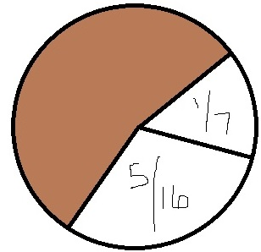
Error patterns indicate formulae before understanding
Find the missing value of a portion of a circle that has two portions labeled with simple fractions | 26 | Added numerators and denominators of the two fractions provided, stopping short of solving [other option was also stop short] | 45
Find the diameter of a circle, given the area. | 26 | Found radius and failed to cancel , stopping short of solving | 37
Find the percent increase between two dollar amounts. | 27 | Found dollar amount increase and labeled it as a percentage, stopping short of solving | 43
 |  | Used larger of the two amounts as denominator when calculating increase | 23

Slide 5
Students learn procedures,
But don’t know when or how to use them, and leave out parts.

Slide 6
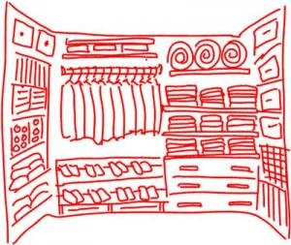
If our brains are closets…
What the expert’s brain looks like (and what we *think* we’re doing in our student’s brains):
From http://usablelearning.wordpress.com/ 2009/04/06/why-your-brain-is-a-closet/

Slide 7
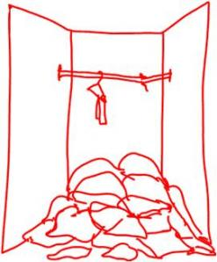
…. The student’s mind…

Slide 8
Hypothesis:
… Grinding our students through the procedures 37 more times is not particularly likely to get them to understand it. It didn’t work before… and it’s not just a correlation; there are reasons it doesn’t work.

Slide 9
Learning procedures without addressing preconceptions:
“students … reject the new information that does not fit with their prior understanding…”
From “Why Can’t Students Get the Concept of Math?” by Julie L. Booth, _Perspectives_ (International Dyslexia Association).
See also http://www.learner.org/resources/series26.html “Minds of Their Own”
So let’s look at some concept-based lessons! Starting with Camtasia…

Slide 10
Perhaps…
“…these students who have failed to learn mathematics in a deep and lasting way up to this point might be able to do so if we can convince them, first, that mathematics makes sense, and then provide them with the tools and opportunities to think and reason.”
(From What Community College Developmental Mathematics Students Understand about Mathematics…)

Slide 11
Some “big ideas”
Address misconceptions. Teach the concepts – and keep teaching them, and keep referring to them.
Adding and subtracting need to be “like terms” to make sense.
Multiplying and division are “more powerful” and take us to higher dimensions such as squares and cubes.
Teach “big ideas” that can be re-used. “Wholes and parts” is one of my favorites. “Things have to balance” is another.
Watch out for “tricks”
Don’t throw out symbol imagery or motor memory –
Connect them with meaning.

Slide 12
Part/Whole”
Many students struggle with solving equations, and this can be built from a basic – but often missing – concept called “parts and wholes.” “6 + 3 = 9,” the student should understand that the 6 + 3 and the 9 exist at the same time;
They’re the same idea, expressed differently.

Slide 13
SIX…
Plus
THREE…
+

Slide 15
These are students who don’t really understand subtraction unless it’s “take away.” If I ask “what do you have to add to 60 to get to 100” I get a mask of confusion.
If I ask “what do I have to add to 99 to get to 100?” I’m told, confidently, “1.”
“How did you figure that out?”
“I added!”
These students aren’t yet seeing 100 as “60 and 40.” It’s just a number. 60 + 40 is a separate idea.
These students don’t know when to expect an answer to be smaller or larger than the numbers they’re working with.

Slide 16
These can’t be my college students!
These folks will get subtraction problems right.
They may get algebra problems right.
They “can do everything but the word problems.”

Slide 17
“Are you looking for the whole or the part?”
Usually, it takes some time to address the “I can’t do word problems” mindset… but then we can get into practicing:
What do I know?
What am I looking for?
Carolyn Dweck http://alumni.stanford.edu/get/page/magazine/article/?article_id=32124

Slide 18
If I know the parts, and I’m looking for the whole, I am probably going to add or multiply.
If I already know the whole thing, but I’m looking for a part of it, then… I’m probably going to subtract or divide.
See http://www.resourceroom.net/mec/index.html

Slide 19
If students *do* understand the “how much more” concept…
Oh! 40 + what?
100 – 40!

Slide 20
They can often be led to…
Oh! X + Y = 100? Y = 100 – x!

Slide 21
Now, when asked for the diameter, given the area…
Students are more likely to be able to know that they’ve only gotten the radius… the part… and that the whole way across is the diameter.

Slide 22
Pythagorean Theorem
Yes, those of us who are facile with formulae can “plug and play,” whether it’s area or the sides of a right triangle.
When I’ve been working with a student who’s been practicing the “part and whole” concept, knowing that “you’ll add to get the big one – the hypotenuse – and subtract to get the small one” simply makes a lot more sense to them, and they make fewer mistakes working with the algebra.

Slide 23
Hidden secrets of the Mathematically Successful
We’re not just contemplating these routines. They have a “feel” to them.
For example: “Change 5 ½ to an improper fraction” usually is tackled with confidence, even if students can’t remember anything else.
Why? It’s a visual-kinesthetic motor memory.

Slide 24
Secret # 2 has 2 parts
They all Look Impossible At First (mindset!)
You can’t always see the end from the beginning
You might have to break things into sections
(e.g., you know the circumference… what *can* you find?)
Don’t lose the parts when you’re getting to the whole!

Slide 25
Secret # 3: Three doesn’t always mean three.
6³
The three is not being added, subtracted, multiplied or divided.

Slide 26
Secret # 4: The “Math Language” isn’t always what it looks like.
7 – (-2) is often answered as “14” because… parentheses mean multiply, don’t they?
Calculator use can mean students aren’t “reading” equations for their mathematical meaning. Students may think 3√9 is different than 3 x 3 because “but if it’s a square root I just put it next to the number, and if it’s a regular number, I multiply.”
Students have all kinds of misconceptions about what math symbols mean that don’t get addressed.

Slide 27
On to the specific strategies!

