Slide 1
Parts and Wholes – Part One
Notes:
**link here to pdf printout/ form that students can fill in and submit. **

Slide 2
Do more than just watch!
There’s a link to a response sheet next to the link to this powerpoint. It will open a text document that you can print out, or fill out online.
By writing down what you’re thinking, you’ll be able to go back and review what you’re learning.

Slide 3
Look at this picture…
What parts of Carla can’t you see?
Picture by Aunt James, who
likes purple ductape.

Slide 4
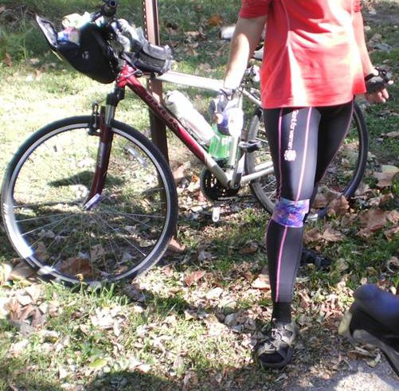
Why do you say those parts of her are there, even though you can’t see them?

Slide 5
Putting ideas into words and being able to explain them takes time and effort, but it will help you learn and remember important ideas – and make connections between them.
You will get smarter ☺

Slide 6
You can name the parts you can’t see, because you know what the *whole* thing looks like.
The parts are still there, even if you can’t see them.

Slide 7
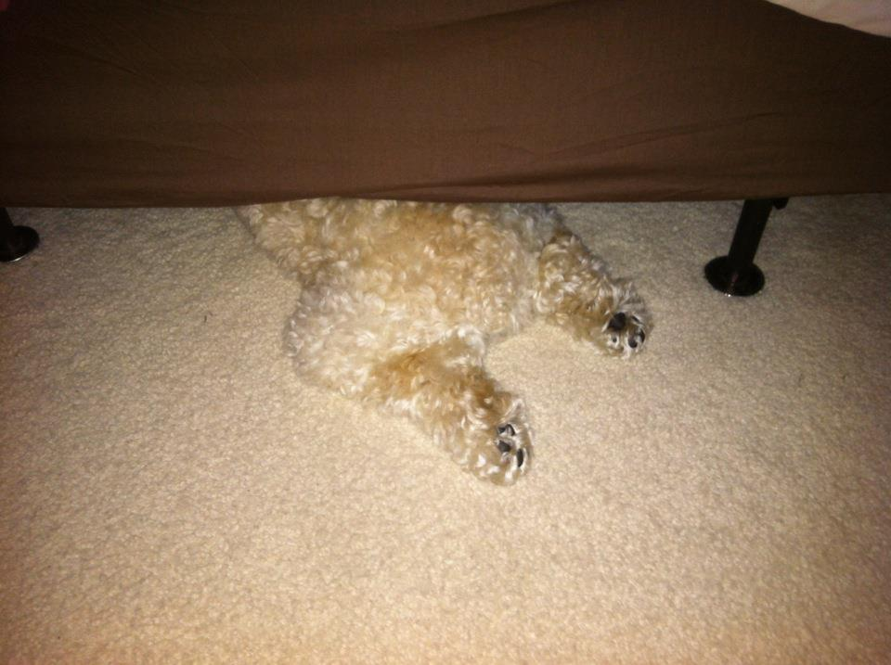
What parts of this puppy (Gravity☺) are not shown in this picture?
Are they really missing, or just out of sight?
You know Gravity has a head and front feet, even though you can’t see them in the picture. (Trust me. He does. )
The big idea here:
The parts of something and the whole thing exist, at the same time… and we can think about either the whole or the parts.
Picture by Tiffany Fish,
whose dog doesn’t like storms! ☺

Slide 8
Let’s see how this works with numbers.
This case of soda has 24 cans in it.
Some are blue, some are purple, some green, yellow and orange.
If we talk about the 4 purple cans, is the whole case still there?
Of course.
The parts and the whole are *both* there at the same time.

Slide 9
The parts add up to the whole…
Ignition charge
+cardboard tube
+delay charge
Firework!
+ wrapping paper
+ star
+ clay seal

Slide 10
But: they are all there at the same time! We just have two ways of talking about them.
Ignition charge
+cardboard tube
+delay charge
Firework!
+ wrapping paper
+ star
+ clay seal

Slide 11
Fireworks or feathers -- The parts add up to the whole.
Vane + rachis + barb + afterfeather + calamus
=
Feather
They’re two different ways of describing exactly the same thing.

